Slide 1
10:00 – 10:45
Maria King
Reflecting on Intersectionality

Slide 2

Reflecting on Intersectionality
The way we view and interpret the world depends on our individual social identities.
Explicitly identifying and reflecting on our identities and intersectionality can help us to identify the impacts of this on us more generally, and in a workplace context.
This can help us identify potential challenges we may experience in the workplace.

Slide 3

Social Identity Map
The following activity was developed by Jacobson and Mustafa, 2019.
Originally developed as a reflexivity tool for considering positionality as a researcher.
Adapted for the purpose of this workshop to support consideration of identity in a workplace context.
Notes:
Jacobson, D., & Mustafa, N. (2019). Social Identity Map: A Reflexivity Tool for Practicing Explicit Positionality in Critical Qualitative Research. International Journal of Qualitative Methods, 18. https://doi.org/10.1177/1609406919870075

Slide 4
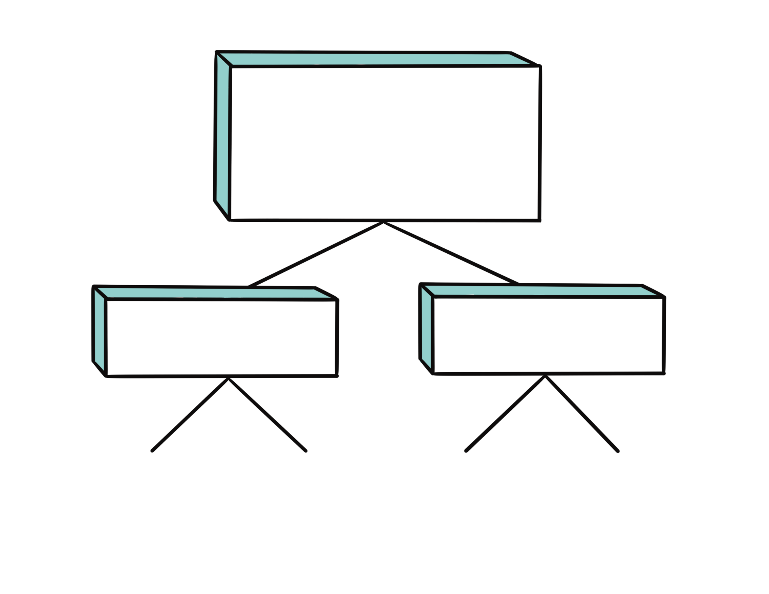
Social Identity Map | Adapted from Jacobson and Mustafa, 2019
Class:
Citizenship:
Age/Generation:
Race:
Cis/Trans:
Sexual Orientation:
Gender:
Tier 1: Facets of social
identity
Tier 2: Broad impacts of each facet
Tier 3: Impacts in the workplace
Professional Identity:
Neuro-Identity:
Spiritual Beliefs:
Ability:

Slide 5

Task 1
Fill in the current facets of your identity in the first tier.
Can complete as many or few as you like and can add extra boxes or change facets where relevant.
E.g. may want to include employment status, nationality, political affiliation
Can choose to discuss as much or as little with others on your table.

Slide 6

Task 2
Fill in the second tier of broader/more general impacts of your identity facets.
Some could be more influential than others and you could choose to focus on just some of these.
Some could be more intertwined or separate i.e. more or less intersectional.

Slide 7
Task 3
Fill in the third tier of impacts of your identity facets in the workplace.
Context and factors within the workplace can also influence the impacts of your personal identity.
You may want to separately note how your current workplace contexts influence these impacts, or reflect on changes between previous and current contexts and impacts.

Slide 8

Summary
Our social identities can change over time, particularly in some aspects more so than others.
You may want to revisit the identity map at a future point to reflect on whether anything has changed for you, either in terms of your identity or impacts.
Other external factors including your workplace context could also change how facets of your identity impact your more generally or in the workplace.

