Slide 1

Navigating the haze of intersectionality
Kirstie Preest
(She/Her)
Notes:
Introduce self and pronouns
Explain image
I apologise in advance if I forget anything halfway through a sentence – however this will mean I’m demonstrating the haze in real time! So please bear with me if I need to regroup.

Slide 2
What we’ll explore:
🍂The intersectionality of forgetfulness
🍂How hidden disabilities, life stages, and symptoms overlap
🍂What this means for our confidence, careers and wellbeing
🍂How we can find our way through, together
Notes:
Today I’m going to talk about the haze of forgetfulness and how that fog from overlapping conditions can affect us at work, through our career and how we can navigate the journey, together with help, support, understanding and kindness.

Slide 3
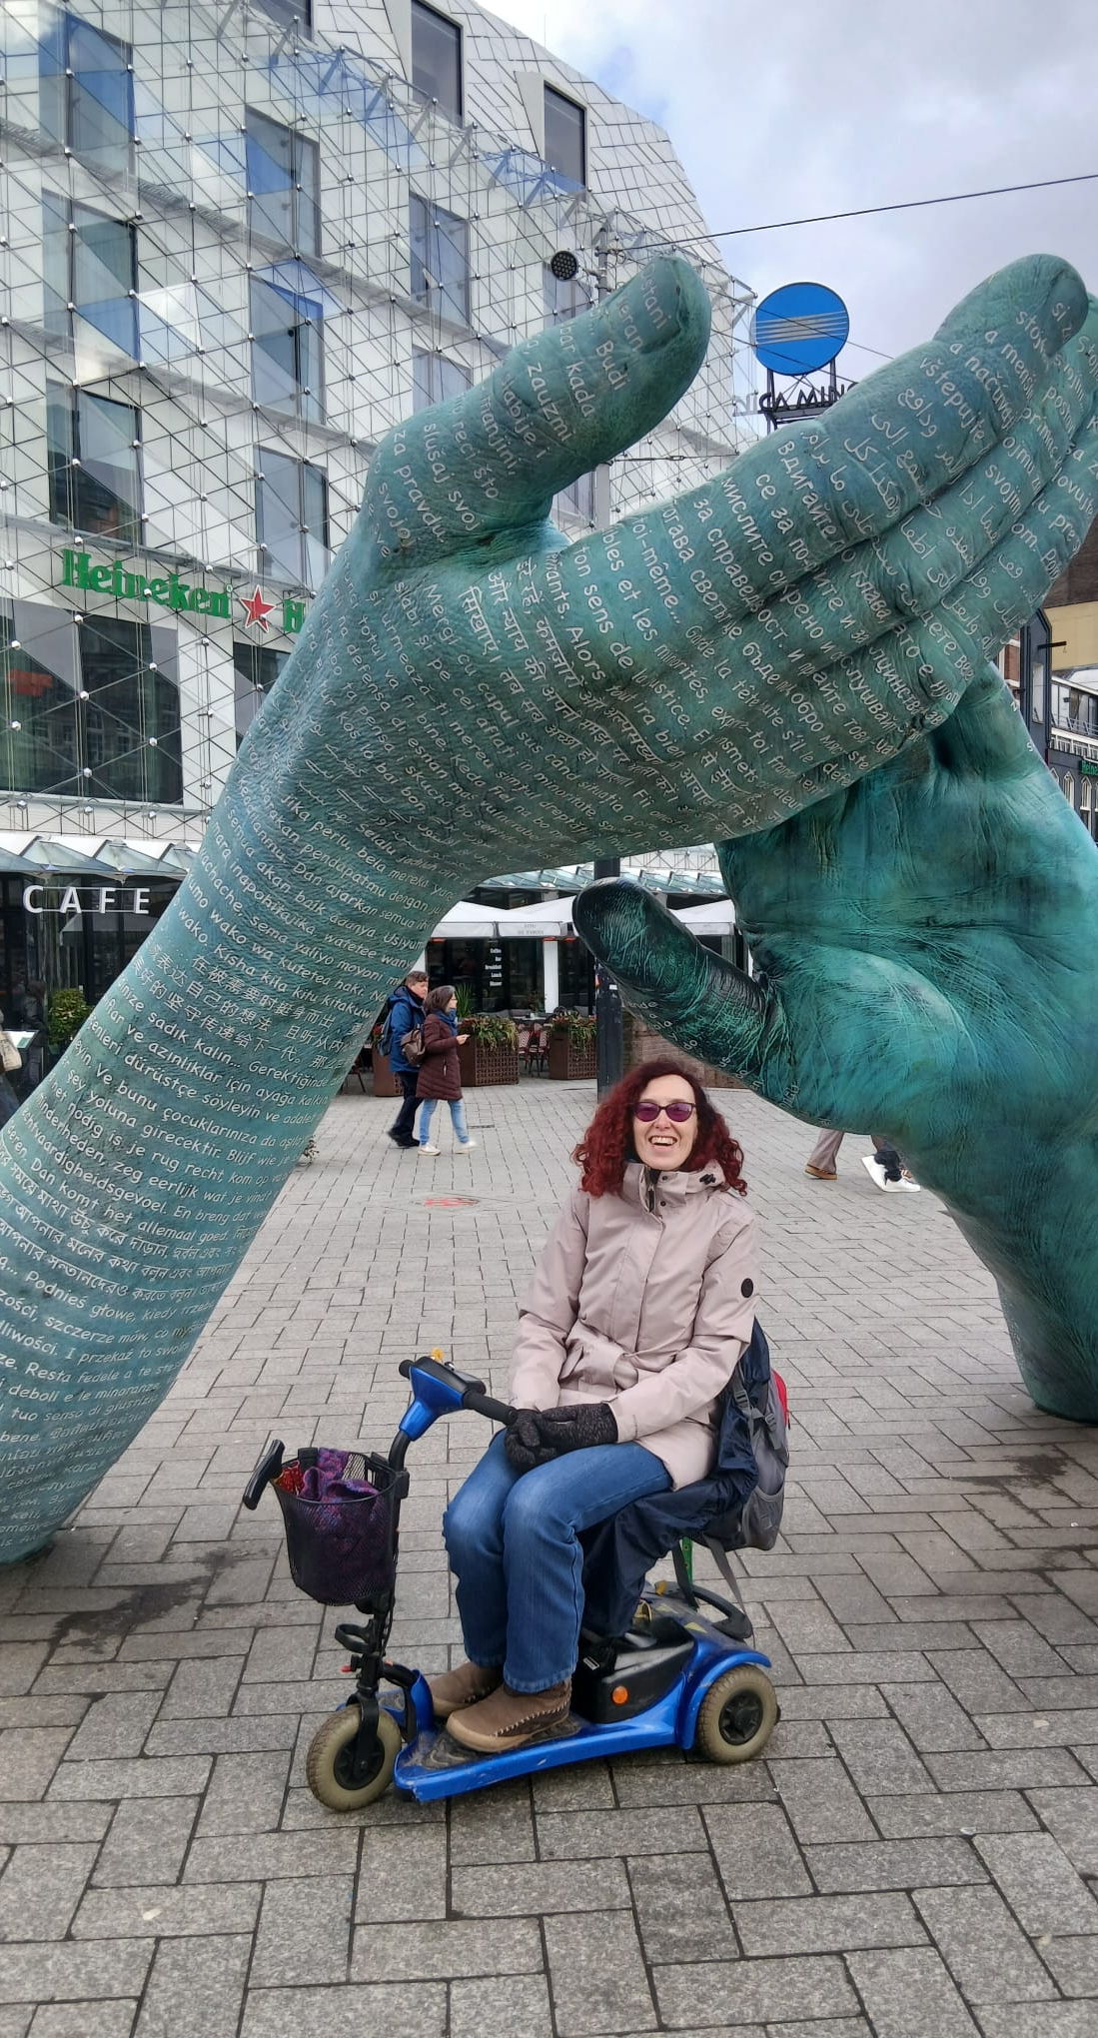
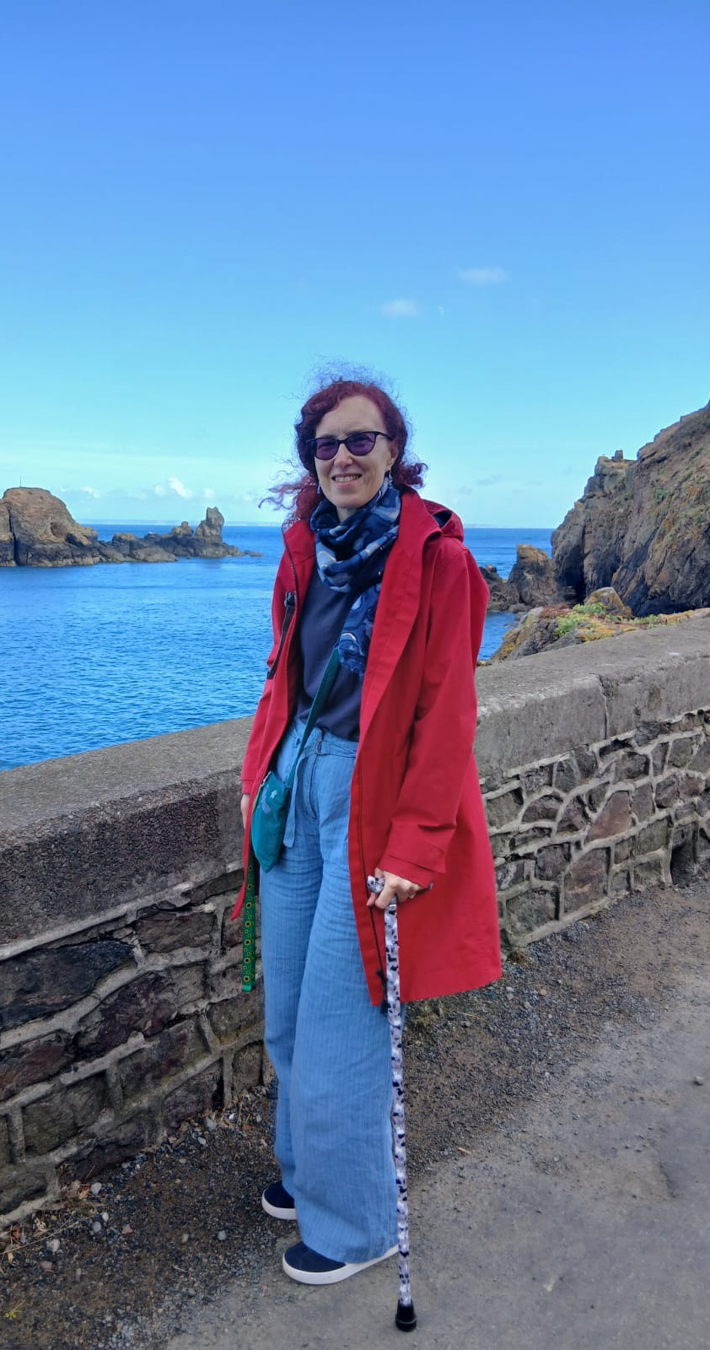
My lived experience
Fibromyalgia
Meares-Irlen Syndrome
(visual stress)
Going through the menopause
Notes:
Explain images
I live with the hidden disabilities of Fibromyalgia, Meares‑Irlen Syndrome, and entered menopause a few years ago.
I was finally diagnosed with fibromyalgia in 2002 after having a car accident in 1992. The main symptoms are chronic fatigue, brain fog, trouble concentrating, muscle pain and low mood. My symptoms vary from day to day, hour by hour, from being relatively ok and able to get around to doing a Bambi impression where my legs give way and I’m deposited on the floor! I use a walking stick and mobility scooter when needs allow, but when I don’t there doesn’t look much wrong with me.
In relation to the Meares Irlen – big bold red letters on a page always lifted off the page and wandered around, but I just thought that was normal growing up! Similarly having to re-read sentences and losing my place were also common but in the 80s were just seen as me being not very good at school and not academically bright! I’d also struggled with bright lighting, having dimmer switches fitted at home and work, using overlays at work, changing the background colour on documents, wearing sunglasses on overcast days, getting a green filter on my glasses to cope with headlights driving at night. The issue came to a head though with the EU directive changing light bulbs to LEDs. It was an Access to Work advisor that suggested I had visual stress in 2019. Once I got my Irlen lenses, interestingly some of the fibromyalgia symptoms weren’t as bad. The lenses help with processing visual information, reading, processing information, brain fog and fatigue but I do need to keep checking my colour as it can change.
So, the brain fog and cognitive dysfunction from both conditions already made it hard to tell where one ended and the other began before menopause joined the mix.

Slide 4
The shared haze!
🍂 Brain fog & cognitive processing
🍂 Forgetfulness & memory issues
🍂 Difficulty concentrating
🍂 Persistent tiredness, lack of sleep & fatigue
🍂 Muscle, joint and head pain
🍂 Sensitivity to light & visual stimuli
🍂 Self doubt & anxiety
Notes:
I remember sitting in College listening to a lecture on menopause by Dr Louise Newson and something in that talk really struck me when she said that many symptoms of the peri menopause and menopause, including widespread muscle aches, joint pain, fatigue, poor sleep, and brain fog over-lapped considerably with symptoms of fibromyalgia.
When you add in the cognitive processing, fatigue and sensory overload of Meares Irlen on top of that, it becomes even worst!
The shared haze of forgetfulness is the triple whammy of both conditions combining with the menopause and resulting in a complex list of symptoms which I’m constantly trying to unravel like a giant puzzle – one you’re trying to solve like an escape room. But where to even begin?
The symptoms all look the similar but come from different places and blur together into a melting pot!
🧠 Brain fog & slowed thinking
📝 Forgetfulness & memory lapses
🎯 Difficulty concentrating
😴 Persistent tiredness & fatigue
🤕 Muscle, joint & head pain
👁️ Sensitivity to light & visual stress
💔 Self‑doubt, anxiety & feeling "not myself"
These all impact on forgetfulness, concentration, cognitive load, confidence, anxiety and day to day functioning: you look fine but feel like you’re functioning at half capacity.

Slide 5

Hidden challenges
When standard answers don’t fit
Medication may not suit
Advice can be conflicting
The journey can be isolating
Notes:
Explain image
Due to the overlapping symptoms it’s not always easy for health professionals to say what causes what! So how I’m supposed to know - I don’t know!
This leads to a lot of trial and error because standard answers don’t fit. As a librarian, and ex NHS librarian, I can play at being Dr Google and look at relevant research and what others find useful, but they don’t always work for me.
There’s no single "right" medication - what medication helps one person may not suit another, tablets may interact with other medication or like me may not be suitable. Gabapentin, for example, made things worse and I lost more of my memory. I find that intolerances and the fibromyalgia make it hard for me to take medication for the condition as well as HRT. Therefore, it a case off just getting on with it or finding alternative therapies or solutions, such as kinesiology.
Some paths aren’t open to everyone, and the advice can be conflicting. You’re advised to take collagen during the menopause and magnesium, but I can’t take magnesium and it took me a while to find a marine only collogen with limited ingredients, as I can’t tolerate bovine collagen.
All of these things can leave you feeling isolated with not much support and people not believing you or thinking you’re fussy.
However, you do become an expert patient after a while and can start helping others which is less isolating.

Slide 6
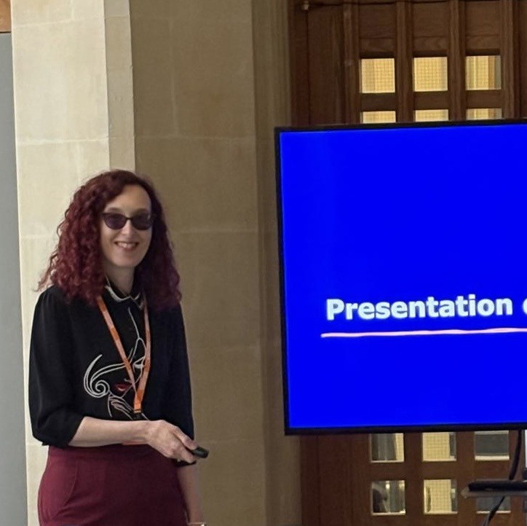
How this relates to work
Feeling unprepared
Still showing up!
Available support
Say what you need!
Notes:
Explain image
Navigating the fog isn’t easy and work can feel like an invisible struggle. Some days you feel ready - some days you show up gently. Bright lights, screens, busy spaces, noise are overwhelming & draining.
At work I’ve forgotten things, asked people to repeat themselves, said the wrong thing, struggled to pull thoughts together, found it hard to remember lots of different information at once, and ultimately doubted myself. It gradually chipped away at my confidence and how I saw my own abilities. But I still needed to carry on, do my job, and show up.
So, I’ve stood in front of students teaching and leading sessions, not remembering who they were, forgetting my words, having complete blanks and talking slowly while I wait for my brain to catch up. I’ve had people comment I need to speed up because they don’t understand my brain is processing. I’ve also been pulled up in meetings in front of others for repeating myself whilst trying to pull my thoughts together. I needed to print documents off on purple paper just to read them and take in the information.
I’ve had to pause, adapt and rest - these aren’t weaknesses. They’re how I keep showing up. However, this can equate to time off, etc and comments around Bradford scoring systems from various HR people.
Line managers or HR personnel may not understand how things affect you so you can find yourself not being believed. It’s important to ask for help, say what you need and check what support is available, i.e. help from Access to Work, Occupational Support, and check organisational policies. Some places may have a menopause policy. But it can be difficult.
Even now, there are days I feel unprepared. I worry I look unprofessional. After all, how does it look - helping others in my freelance life build their confidence in teaching yet struggling to find the words myself? But I can’t just pause life until it all goes away.
So, I keep going, dredge up the confidence from somewhere and continue to show up – even when everything feels foggy or I don’t have a clear head.
Some days I might not be “on it” and I need to remember that’s ok.
In my other part-time job, my experiences are really useful and help me support my students.

Slide 7
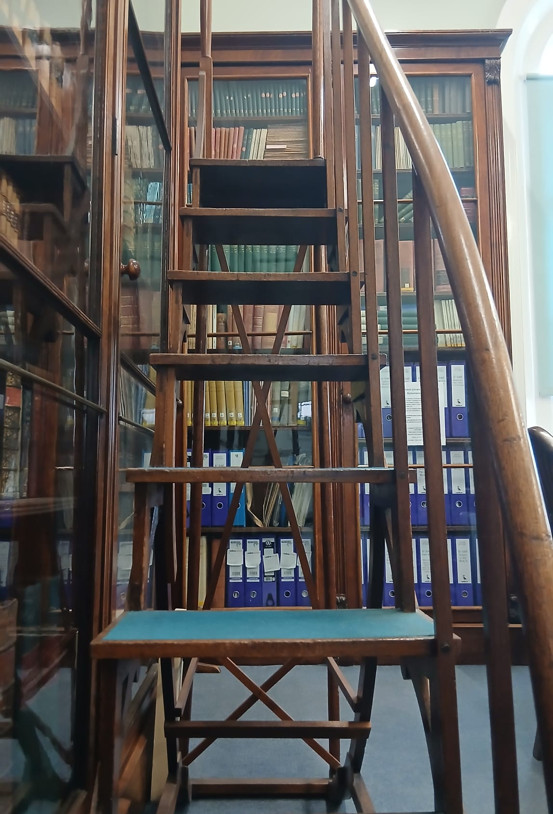
How this relates to your career
Lack of confidence
Self doubt
Advancement is different for everyone
Disabilities shouldn’t be a barrier!
Notes:
Explain image
Career wise, the fog can really knock confidence in yourself. Self doubt creeps in and you don’t necessarily believe in yourself and your own abilities.
The fog really made me feel I couldn’t do things anymore and I felt I wasn’t keeping up within the profession. AI for example, for a couple of years seemed to be a complete horror – I just couldn’t get on with it, I struggled to take new information on board full stop.
In the words of Elle from legally blonde “if the fabric doesn’t work with you don’t work with it!” Eventually, I decided that freelancing and changing my focus to support students with disability and access needs worked best for me. Working for myself means I can go at my own pace, take the time I need and rest when I need to.
Therefore, my views on career and advancement have changed. Career progression doesn’t always look the same for everyone and can be a meander or a pivot rather than a straight line. But I will say that visibility matters and seeing someone like you still managing to lead and be in those strategic positions makes a huge difference.
Need to tell yourself that your disabilities and health aren’t a barrier but your greatest strength – I now use my disabilities to help others and talk about them.

Slide 8

How this relates to wellbeing
Rest
Listen to your body
Be kind to yourself
Your health comes first!
Notes:
Explain image
In terms of wellbeing, the saying “you can’t pour from an empty cup” is a good one. Listening to your body and what it needs is crucial.
I have to remember that rest isn’t giving up - it’s being able to continue another day. Remember rest can also be doing something different like taking a walk, crafts or yoga.
Compassion for yourself matters as much as compassion for others. Knowing that some days less is more because your health comes first.

Slide 9

What we can do together…
See the whole person
Ask what can help
Listen and provide support
Share experiences
Notes:
Explain image
I encourage everyone to look at individuals as a whole person. We don’t know what individuals are carrying and going through each day. We’re all a blank slate to each other.
If you think someone is struggling don’t assume knowledge, use active listening and ask what helps each person individually. Everyone’s needs are different even if they have the same condition, what affects one person may not affect another. Ask if they need reminders, understand that something might be late or if an email hasn’t been answered.
You may not know how to help but you can listen, be supportive, empathetic and help find out what support is available.
Sharing experiences can also help people not feel alone.

Slide 10

Any Questions or thoughts?
Notes:
Explain image
Has anyone got any questions or thoughts they would like to share?

Slide 11
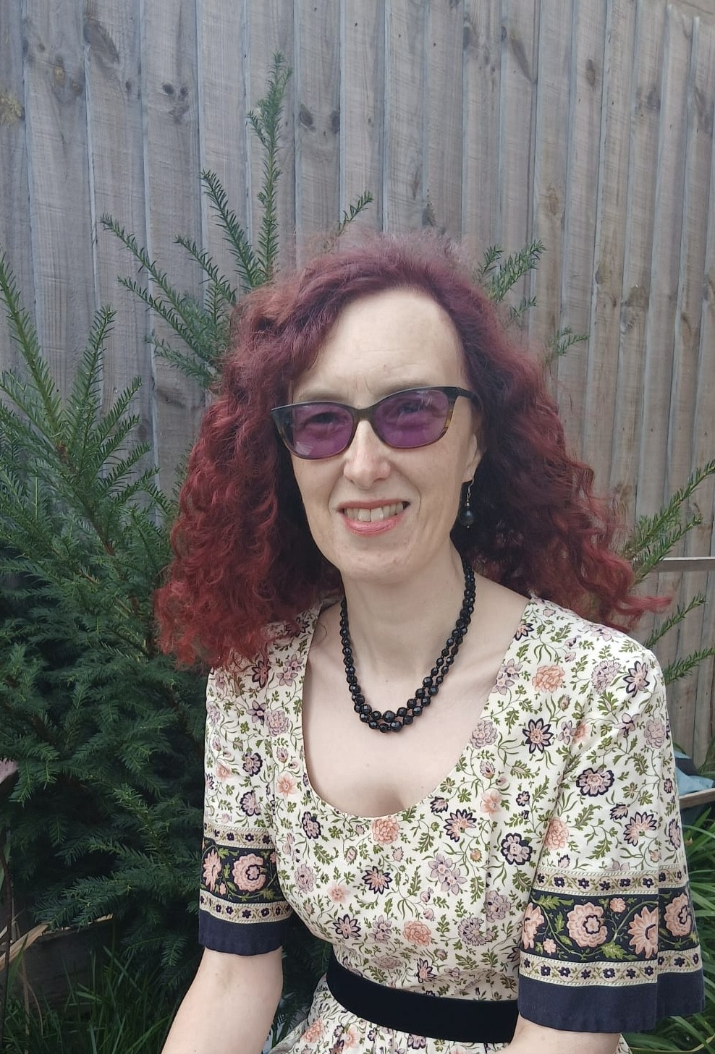
Contact details
Kirstie Preest (She/Her)
Freelance Library Consultant & Trainer
kirstiepreest@hotmail.co.uk
Notes:
Explain image
Thanks very much for listening. I’d like to leave you with one last question – how are you going to support others going forwards?

