Slide 1
The experiences of neurodivergent professionals working in academic libraries - recommendations for practice
Clare Camp (she/her)

Slide 2
Outline
Background
Aims and objectives
Research questions and methodology
Findings and interpretive framework
Recommendations
Questions and answers

Slide 3

Check in
Word or emoji in the chat

Slide 4

Background
Library and Information Services Management MA
Personal motivation
The big picture
The LIS context
The gaps

Slide 5

Terminology
Neurodivergent – having a mind that diverges from the “norm”, usually as consequence of having one or more neurodivergent conditions.
Neurotypical – having a mind that falls within the “norm” or without one or more neurodivergent conditions.
Executive Functioning – skills used to manage everyday tasks including organisation, planning, time management, working memory, emotional regulation and impulse control.
Masking – the act of suppressing or concealing neurodivergent traits to appear neurotypical.

Slide 6


Research aim and objectives
Research aim
Investigate the experience of neurodivergent individuals working in the LIS profession within an academic library in a large research-intensive university in England, using King’s College London as the location for a case study.
Objectives
Develop insight
Reveal how neurodivergent staff perceive their professional strengths
Expose the barriers that exist for neurodivergent staff
Make recommendations for improvement based on lived experience

Slide 7


Research questions
How do neurodivergent LIS staff working in an academic library describe their workplace experiences, including recruitment, the physical and sociocultural environment, and their daily work and tasks?
What accommodations or adjustments within the LIS workplace environment are most valued by neurodivergent staff, how are these accessed, and what is their impact?
What professional skills and strengths do neurodivergent staff describe themselves as having, and in what ways are these harnessed and developed within the LIS profession?

Slide 8


Participants and methodology
Participants
Six participants recruited.
Participants represented a mixture of neurodivergent conditions, differing levels of seniority, role and length of service.
Methodology
Semi-structured interviews were conducted, and interview data was analysed using Braun & Clark’s (2022) thematic approach.

Slide 9
Findings

Slide 10

Familiarity, recall and “thinking on your feet”
Familiarity with typical recruitment practices increased participants comfort and preparedness.
Challenges with recall make interviews overwhelmingly a negative experience reported by participants.
Participants expressed that good performance at interview was about being good at thinking on your feet, rather than demonstrating suitability for a role.

Slide 11
Quotes from participants
…my mind goes everywhere. (P3)
I can just be on a roller coaster that I’m not quite in control of and I genuinely won’t know where I’ve been by the end of a sentence or a point. (P5)
(Good performance at interview is)…about thinking on your feet and how you interpret quite a broad questions. (P4)

Slide 12

The physical, sensory world
Control and personalisation of the working environment was described as important.
Sensory processing difficulties in office spaces were highlighted as challenging.
Adjustments to spaces were often required to mitigate the stresses, but these were difficult to acquire.

Slide 13
Quotes from participants
It’s my own space. I can decorate it and use it as necessary or in a way that’s appealing to me. (P1)
The other day I was trying to do some online training…and you see people just talking for ages…I was reading the same line over and over…But of course, I can’t tell them to shut up. It’s not fair. It’s a shared space. (P3)
It feels like (there) aren’t any quiet spaces for me to just crawl away…somewhere where if I wasn’t working just like to decompress…that would be ideal, having somewhere to go and cocoon. (P4)

Slide 14

Social connections, masks and authenticity
Interpreting social cues presents challenges in the workplace.
Participants described being preoccupied with the way they are perceived by colleagues.
The necessity to mask to manage social challenges limits authenticity in the workplace.

Slide 15
Quotes from participants
How am I being perceived? I want to behave…Am I smiling enough? Am I being polite?...It’s the whole thing. (P4)
Through many years of socialisation and being out in a kind of non-neurodivergent world…I’ve built a lot masking and coping so I don’t think…I…know what my authentic self is at this point. (P5)
I have to be careful to not talk over people because my brain moves so fast ahead of my mouth. (P1)

Slide 16

Routine, structure, disruption and procrastination
The need for routine and structure versus novelty and variety varied between participants.
Shifting between tasks or being disrupted or interrupted presents significant challenges, leading to procrastination.
Neurotypical managers struggle to understand neurodivergent ways of working, offering solutions to time or workload management that are not suitable.

Slide 17
Quotes from participants
I think one of my biggest challenges is what I think is structure against what my supervisors may think is structure…the way I tried to work with the managers and senior managers to try and structure it…never worked. (P1)
I will probably spend the first couple of hours procrastinating and looking at this long to do list that I need to do…And as the day goes on and I realise it’s now the afternoon…that’s when I’ll cram absolutely everything in to get it done. (P6)

Slide 18

Luck, professional skills, and development
Articulating professional strengths was challenging for participants.
Participants were likelier to attribute their achievements or successes down to luck, rather than their skills.
Systemic barriers exist for disabled and neurodivergent staff in accessing development opportunities.

Slide 19
Quotes from participants
I have a lot of conversations with my manager where I feel like I’ve just fallen into every job I’ve ever had. (P4)
I think decisions have been taken about my duties and development without consulting me and it is a cause of immense frustration because I think my employer is frightened of discussing these things with me…There is a barrier in being honest and frank about the barriers to career progression that exists for disabled and neurodivergent people because they’re frightened of being accused of discrimination, I think. (P2)
I find it quite difficult to reflect on my strengths. (P6)

Slide 20

Being neurodivergent in a neurotypical world – the emotional toll
The emotional impact of being neurodivergent in a neurotypical world manifests as stress, anxiety, frustration and sadness.
Participants disproportionately share the burden of the emotional labour for advocating for better neurodivergence awareness.
Academic libraries were perceived as more positive workplaces for neurodivergent employees, though there is still a lot more to be done to improve.

Slide 21
Quotes from participants
Just as many things to do with my disability, I feel I have the burden of having to explain things over and over and it wears me down. (P2)
Although there may general greater awareness about neurodivergence, this is accompanied by a damaging spread of half-truths and myths about neurodivergent conditions. (P2)
Sometimes I think you can be conscious of asking too many questions…I think a lot times it’s difficult to try and get across “I’m not like taking the mick or anything.” I’m just legitimately trying to understand what you mean. (P5)

Slide 22
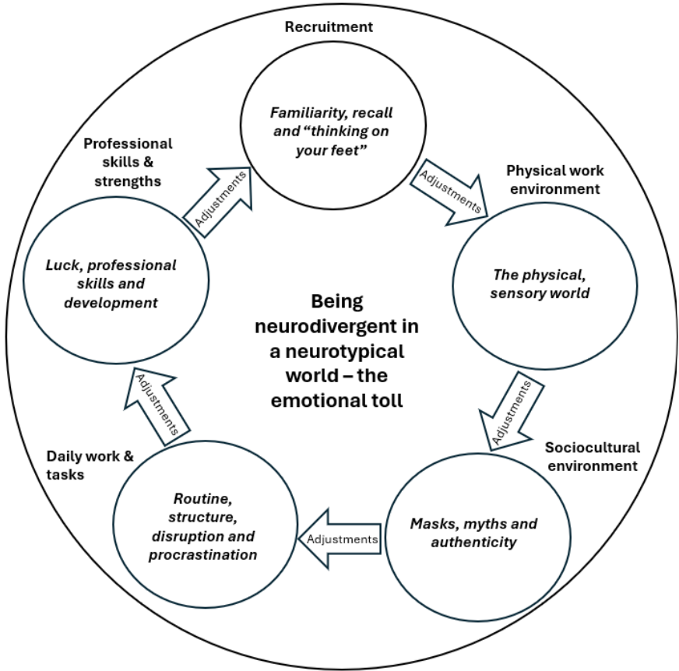
Interpretative framework

Slide 23
Recommendations

Slide 24


Recommendations
Recruitment
Recruitment practices should be reviewed to reduce stress, uncertainty and ambiguity.
Clarity on adjustments available should be provided by potential employers.
Interview questions provided in advance to all candidates, irrespective of disclosure.
Physical work environment
Employees should be made aware of the level of environmental control they have in the workplace.
Neurotypical managers should improve their awareness of the impact of sensory sensitivities for neurodivergent staff.
Consider adopting zoning policies for staff spaces to provide options for all auditory sensory needs.

Slide 25


Recommendations
Sociocultural environment
Daily work and tasks
Neurotypical managers should improve their awareness of the impact of masking on neurodivergent staff.
A wide variety of different social opportunities should be offered that accommodate neurodivergent staff.
When strategising cultural values, senior managers should seek out feedback from neurodivergent staff.
Flexibility, clarity and autonomy should be given to neurodivergent staff about how their daily work.
Neurotypical managers should improve their awareness of the impact of executive function difficulties on neurodivergent staff.
Productivity measures should be focused on outputs, not ways in which tasks are achieved.

Slide 26

Recommendations
Professional skills and strengths
Alternative pathways into the profession should be explored to attract and support neurodivergent people to enter the profession.
Neurotypical managers should increase their confidence in discussion professional development opportunities with neurodivergent employees.

Slide 27
Check in
Word or emoji in the chat

Slide 28
Questions and Answers
Thank you

Slide 29
References and resources
ACAS. (n.d.) Neurodiversity at work. Retrieved February 20th, 2026, from https://www.acas.org.uk/neurodiversity-at-work.
Camp, C., & Finlay, J. (2025). The experiences of neurodivergent Library and Information Science [LIS] professionals working in academic libraries – a case study. The Journal of Academic Librarianship, 51(5), Article 103115. https://doi.org/10.1016/j.acalib.2025.103115
Fair Library Job Manifesto. (2022). Fair Library Job Manifesto. Retrieved February 20th, 2026, from https://sites.google.com/view/fairlibraryjobs/manifesto.

Slide 30
References and resources
National Autistic Society. (n.d.). Autism and sensory processing. Retrieved February 20th, 2026, from https://www.autism.org.uk/advice-and-guidance/about-autism/sensory-processing.
Neff, M.A. (2023, May 31). Understanding sensory overload and its impact on emotions. https://neurodivergentinsights.com/sensory-overload-and-emotions/?srsltid=AfmBOopUSaz2gaf4j6R9owNTlT9bztVoAo8MqiD_8IBbIEAmMGeaKB_H.
Royal College of Nursing. (n.d.). Inclusive recruitment. Retrieved February 20th, 2026, from https://www.rcn.org.uk/Get-Help/Member-support-services/Peer-support-services/Neurodiversity-Guidance/ND-recruitment.

Slide 31
References and resources
The Brain Charity. (2023). What is masking, what does it look like and how can it affect people? Retrieved February 20th, 2026, from https://www.thebraincharity.org.uk/what-is-masking/.

