Slide 1

Navigating Accessibility in a Customer Facing Role

Slide 2
Agenda
Introduction to my role
Interview Process
Adjustments
Discrepancies with our team and other teams
Accessibility for students compared to staff

Slide 3

Meg Hoy
Information Support Assistant
Customer facing role
2 years experience
Fully based on campus

Slide 4
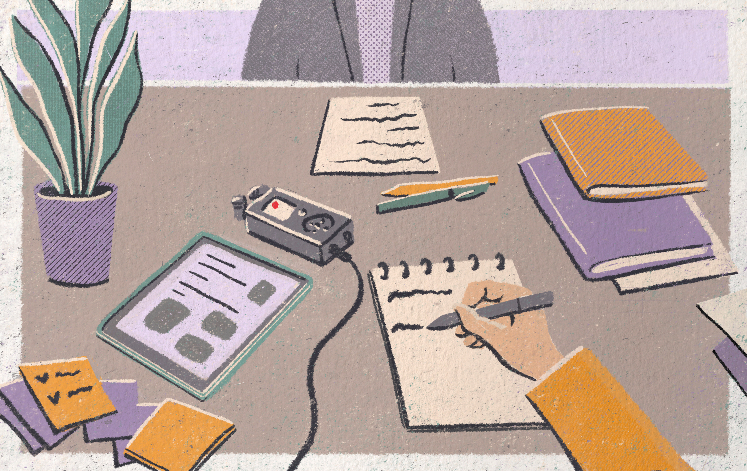
Recruitment
My interview process:
No preparation time for questions
Group task
New interview process:
Trialed different preparation times
Reconsidering group task

Slide 5

Adjustments
First full-time job
New to adjustments in the workplace
Other team members also struggled
Environment makes it difficult to implement adjustments

Slide 6

Staff Accessibility Network
Access

Slide 7

Discrepancies with our team and other teams
Varying timetables
Noisy environment
“Use your judgement” approach
No fixed workspace
Need to be constantly available to students

Slide 8
Discrepancy with our team vs students
Workshop around neurodivergent students in the library
Adjustments made more easily for students
Outdated ideas around customer service
Long term focus – make every space an accessible space

Slide 9

Thank you

