Slide 1

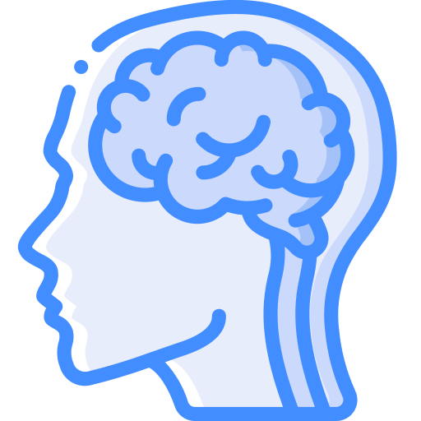
Comparing Brains
Joanne Fitzpatrick
Open Research Librarian @ Lancaster University
Co-Chair NLISN
Diagnosed Autistic
Notes:
I’m going to do a quick talk regarding how I approach reasonable adjustments, through something I call ‘comparing brains’

Slide 2
Contents
Why are reasonable adjustments so hard for ND people?
What do you mean by comparing brains?
How did you get so good at comparing brains?
How do I compare my brain with others?

Slide 3

Why are reasonable adjustments so hard for ND people?
What do you need to do that you can’t do now? Feel OK? Understand things? Remember things? Act right?
How do I know that I’m not doing those things?
Might be able to do them, just not ‘correctly’.
If I identify something – how do I know what will help?
This list of suggestions – how do I know it will work?
How do I tell people I need this?
Who do I tell?
What happens on days when I don’t need it?
What happens on days when I discover something new I need?
++ How do I know I’m neurodivergent, and what neurotype I have?
Notes:
From 6 onwards, all disabled people struggle with this
The answer to up to number 5 could be by Comparing Brains, and it will definitely put you in a position to answer the rest

Slide 4
What do you mean by comparing brains?
I mean you answer those Gold Stripe questions
Not through examining your own mind, because it’s not a typical one
But through comparing it with others, both ND and NT
To orient yourself within typicality, and atypicality
And get those questions answered for yourself

Slide 5
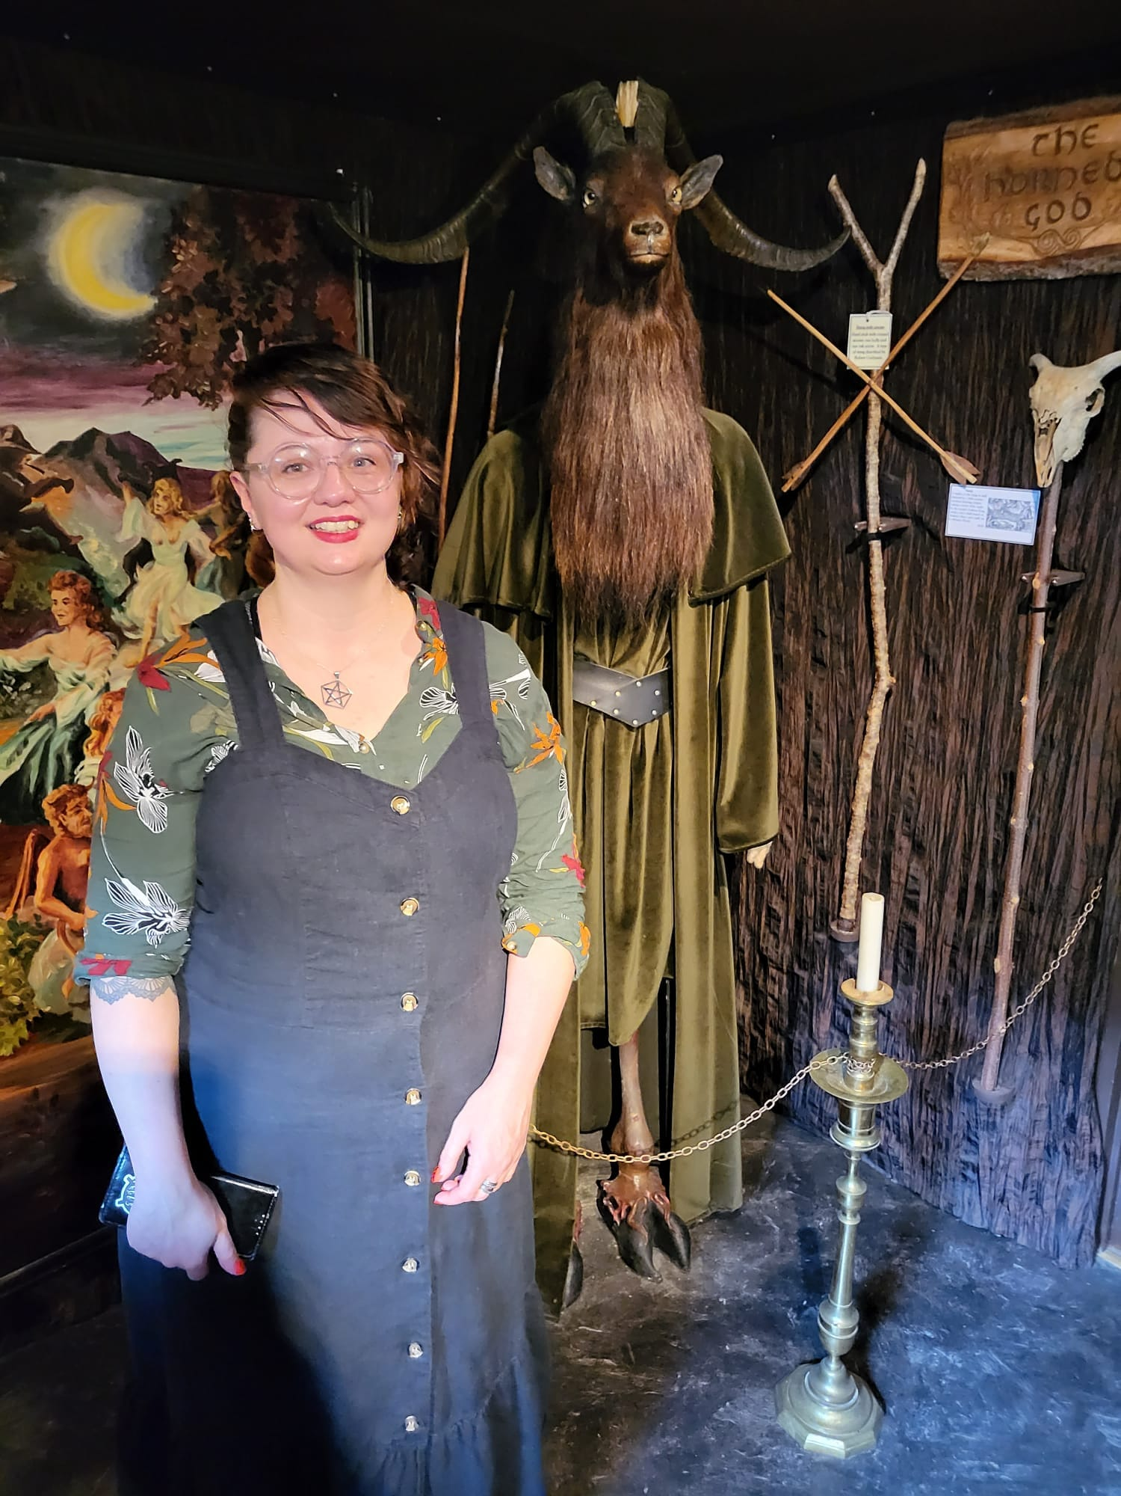
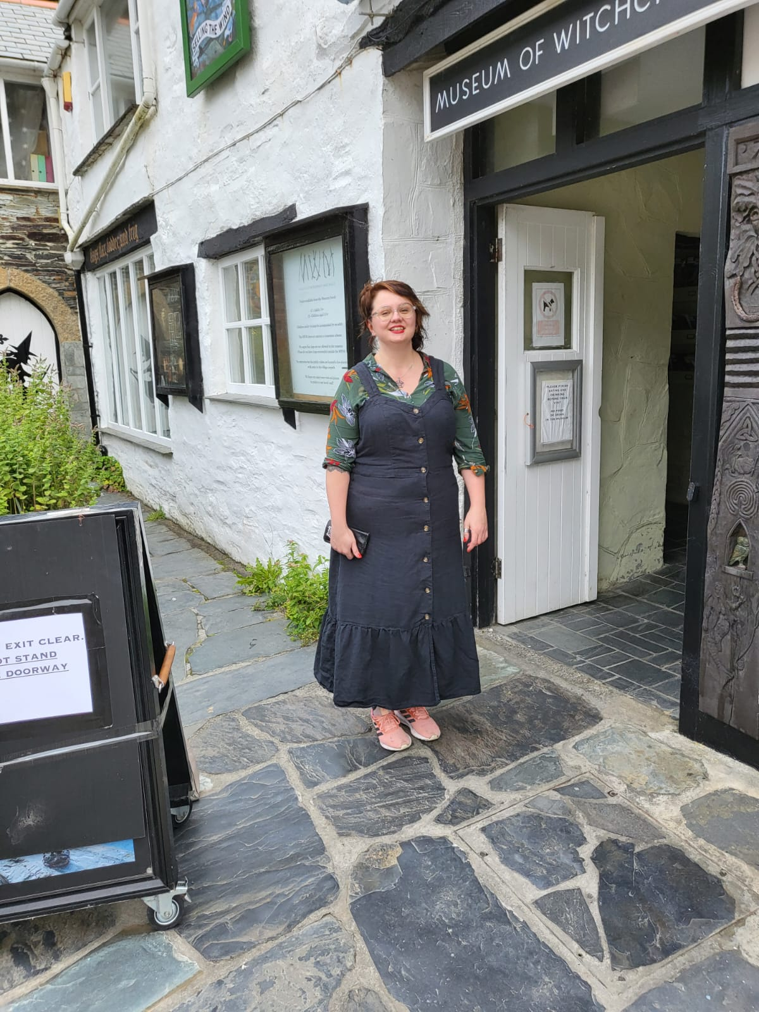
How did you get so good at comparing brains?
I do loads of alternative religion and spirituality stuff! It’s my special interest.

Slide 6
What I get up to
Comparing Brains
Meditation
Pathworking
Divination
Magic
Ritual
Gnosis
I answer my spiritual longing
Not through just myself, I’m just a human
But through comparing experiences of divinity with others in the relative
To orient myself within the absolute cosmos
And experience true divinity for myself
Notes:
Been at it since I was a teenager, that’s how I got so good at it

Slide 7
How do I compare my brain with others?
Meditation
  Turn inwards – self examination
Pathworking
  Know yourself - describe your experiences
Divination
  Read up to the ‘critical mass’
Magic
  Experiment and examine results
Ritual
  Find the others – talk with trusted others
Gnosis
  Tada! You’ve found your reasonable adjustment
Notes:
Takes practice and getting used to this if you’ve never done it before

Slide 8
Example
Turn inwards
  I made a decision to monitor my own stress responses
Know yourself
  I noticed I get upset when loud sounds are unpredictable, but not when they are regular
Read
  I read about noise and routines and autism, it’s a thing!
Experiment
  I tried out some earplugs to block out background speech (didn’t work, still stressed the same)
Find the others
  I spoke to others about their issues with sounds, both NT and ND
Gnosis
  Please can I work from home and avoid the open plan office
Notes:
It might not always work, but those are the times when you have to admit there’s no good solution and that’s the burden of the disability
But this is the difference between a managed neurodiversity and an unmanaged neurodiversity, and you’ve done all you can
It is 100% extra work and takes time, but we don’t have a choice but to do it, and it’s worth it

Slide 9

Thankyou!
It’s Question Time!

