Slide 1

Equality, diversity, and inclusion in the research library: looking at recruitment practices
NLISN Event - 10/07/2025
Dr Christina Kamposiori, Executive Programme Officer,
Research Libraries UK
@CKamposiori
@RL_UK
www.rluk.ac.uk

Slide 2


Context
Research Libraries UK (RLUK)
Consortium of 39 of the leading and most significant research libraries in the UK and Ireland.
An elected Board of Directors sets out the strategic direction for RLUK activities.
The RLUK Executive delivers the strategic plan in collaboration with member libraries and other stakeholders.
RLUK Strategy 2022-2025 - The Library Transforming:
      Highlights the transformative potential of libraries.
      5 different strands of work & 3 cross-cutting themes.
      EDI is one of the cross-cutting themes, acting as a provocation and an opportunity.
https://strategy.rluk.ac.uk/

Slide 3
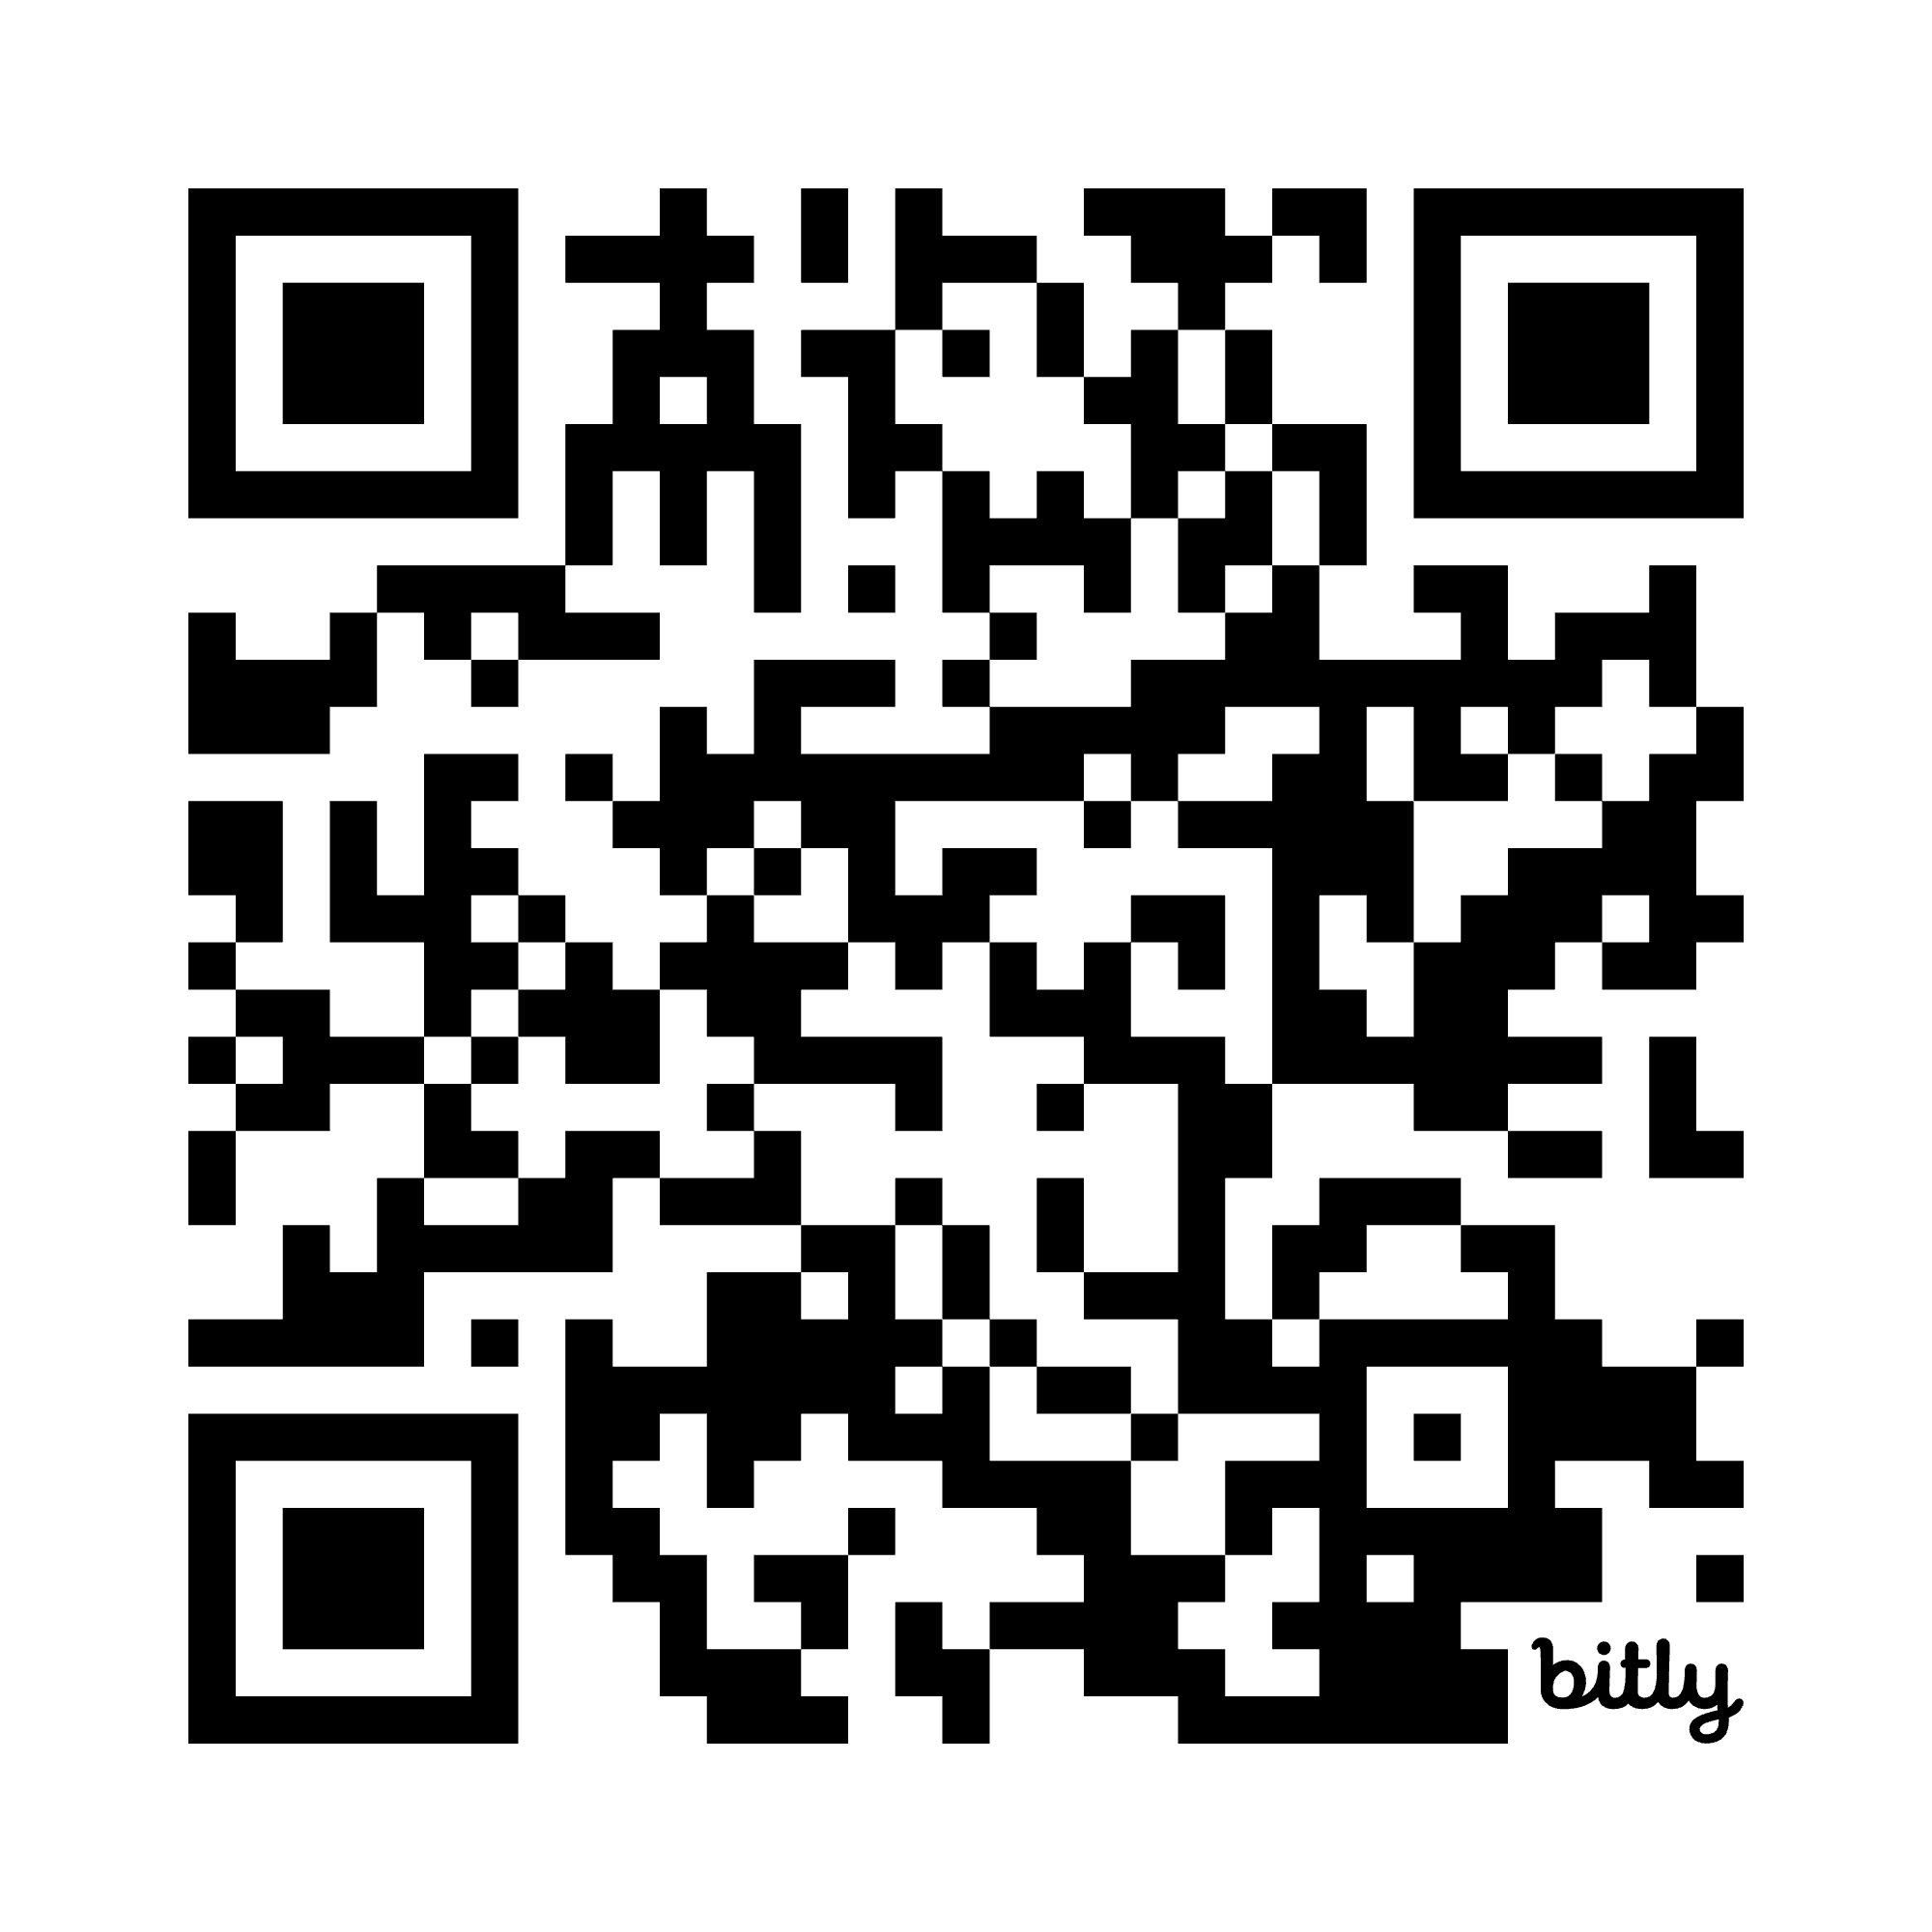
Background
      The Research Libraries Position Description Bank (RL PD Bank) is a collection of position descriptions (PDs) from major academic and research libraries. It fosters the sharing of information through a browseable and searchable database that provides access to a national collection (or bank) of PDs.
RLUK joined the RL PD Bank in 2021.
Since then, 21 RLUK members have contributed 675 PDs.
RL PD Bank as a resource to investigate issues around workforce development and the evolving role of the information professional in research and academic libraries.
RL PD Bank

Slide 4
Purpose
Focused research
Investigate how issues around equality, diversity, and inclusion (EDI) are represented in the job descriptions of RLUK member institutions.
Explore how libraries apply EDI values to their recruitment practices.
Identify new roles, including leadership positions, that are being created to drive EDI initiatives and contribute towards culture change within institutions.
Explore the international context through a comparison to initiatives being undertaken by US and Canadian research libraries.
www.rluk.ac.uk

Slide 5
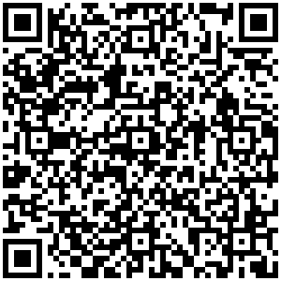
Methodology: Job description analysis
Detailed analysis of 319 RLUK job description submitted until August 2022. Focused on direct and indirect references to EDI.
Examples of direct references to EDI:
Roles which include language directly linked to EDI in their title
Relevant EDI language in the main body of the job description either as part of a positive statement, the role duties and description, or a person specification.
Examples of indirect references to EDI:
Language and expressions as part of the role title, description, duties, and person specification that does not directly refer to EDI but can be considered
supportive of EDI.
Access the Report

Slide 6
Methodology: Interviews
Institutional policies or strategies around EDI
What or who drives change in the institution
Roles that have been particularly created to drive EDI initiatives
Representation of EDI issues in the RL PD Bank job descriptions, including direct and indirect references to EDI
Recruitment practices and how they support EDI
Interest in the development of a programme for emerging leaders
Collection and use of statistics in support of EDI
Semi structured interviews with representatives of six RLUK institutions.
The questions focused on a number of issues.
www.rluk.ac.uk

Slide 7
Methodology: International Landscape Analysis
Aim:
Look for relevant positions, especially leadership roles, that have been created by institutions in the US and Canada as well as gain an insight on how issues around EDI are represented within the body of the position descriptions (e.g. duties, person specification, positive statements).
Keyword searching to explore 4900 in total from ARL, ASERL, CARL, RLUK:
      Keyword searches based on the terminology used to refer to EDI issues and initiatives in the RLUK job descriptions in the RL PD Bank.
      Terms informed by the interview discussions and the type of terminology generally associated with EDI in the UK and beyond.
www.rluk.ac.uk

Slide 8
Findings: Statements & Values
The majority of RLUK job descriptions in the PD Bank included some type of positive or EDI statement.
Often found at the bottom of the job description template and referred to the strategic plan and values of the library’s home institution around EDI.
RLUK members had relevant policies which implied that EDI is part of a library’s goals, values, and working practices.
Mostly found within the body of the job description (e.g. responsibilities and person specification) rather than at the beginning or end of the template.
Statements that did not refer directly to EDI or included relevant language but could be considered supportive of EDI.
Example: statements referring to family-friendly policies or flexible-working.
www.rluk.ac.uk

Slide 9
Findings: EDI-focused roles
Based on job description analysis:
7 RLUK job descriptions with direct references to EDI (e.g. specific terminology) in the title of the job description
Ranged from relatively junior (e.g. at internship level) to managerial and leadership positions (1 leadership position).
Duties: working with and supporting communities from specific ethnic backgrounds or with other protected characteristics, or aiming to make collections more inclusive through decolonisation.
Some job descriptions included terminology in their titles that did not directly refer to EDI, but could be considered supportive of EDI (e.g. ‘access’, ‘participation’).
Context based on interviews:
Difficult to justify the creation of EDI-focused roles (especially senior) as home institutions often have EDI offices or other teams and groups that oversee EDI initiatives across the institution.
Easier to create junior roles with a focus on collections or community support.
www.rluk.ac.uk

Slide 10
Findings: Role responsibilities and person specifications
The majority of RLUK members had submitted position descriptions that included direct or indirect references to EDI in the role responsibilities and person specification sections.
Some institutions preferred to include more general EDI-related responsibilities across many of the job descriptions they had submitted to the RL PD Bank.
There were different approaches regarding the presentation of this information.
EDI duties included in the portfolio of responsibilities of senior roles.
Based on the interviews, it is often easier to add relevant responsibilities when recruiting for an existing role (e.g. after it has been recently vacated), than create a new one.
Majority of RLUK roles do not list advanced degrees or degrees on specific disciplines or other qualifications as essential requirements, unless necessary.
www.rluk.ac.uk

Slide 11
Findings: Beyond job descriptions
RLUK members have internal EDI policies or codes of ethics, but they tend to align their general approach to the home institution’s strategic goals and ambitions.
Steps to make recruitment practices more inclusive:
Changing the approach through which job descriptions are developed and looking to publish these outside mainstream channels
Library staff undertake relevant training
Gender-balanced interview panels that bring together a variety of views
Anonymising job applications to remove unconscious bias
Taking into account the needs of potential candidates (e.g. candidates with neurodivergent profiles)
Grassroots groups and other EDI committees have important role in workforce development and retention
Organising open days to support inclusive recruitment and retention
Projects aiming to enhance understanding of the library’s workforce and broader community
www.rluk.ac.uk

Slide 12
Findings: International comparison
A variety of roles from all areas of the library and from different levels of seniority with direct references to EDI submitted by research and academic libraries in the US & Canada
984 entries by ARL, ASERL, and CARL which had all three terms ‘equity’, ‘diversity’, and ‘inclusion’ anywhere in the job description. No RLUK job description included all these three terms.
Search with the terms ‘diversity’ and ‘inclusion’ anywhere in the job description, brought up a larger number of entries, including several RLUK entries. ‘Diversity’ as the most popular term.
The terms ‘inclusion’, ‘equity’, ‘disability’, and ‘race’ brought up a significant number of entries, especially by ARL institutions.
Term ‘equity’ preferred by US and Canadian institutions - the term ‘equality’ is more widely used by RLUK member institutions.
Several PDs, especially by ARL institutions, had direct references to EDI in their title.
RLUK members had 7 PDs with direct references to EDI, while CARL had no entries with EDI terms in the titles of job descriptions.
www.rluk.ac.uk

Slide 13
RL PD Bank: Updated Research
Updated research data (as of 3rd July 2025):
RLUK
No PDs with the terms ‘neurodiverse’ or ‘neurodivergent’ anywhere in the job description.
1 PD with the term ‘neurodiversity’ in the body of the job description – it referred to the duties of the professional who will be holding the role which will include supporting students and users with neurodiverse profiles or disabilities.
ARL (major contributor to the RL PD Bank with many members prioritising DEI until recently)
No PDs with the terms ‘neurodiverse’, ‘neurodivergent’ or ‘neurodiversity’ anywhere in the job descriptions.
Regarding other terms which were used as part of the research conducted in this report, some updated information (as of 3rd July 2025) is:
RLUK
Term ‘inclusion’ anywhere in the job description: 349 PDs (146 in 2022)
Term ‘equity’ anywhere in the job description: 71 PDs (0 in 2022)
Term ‘equality’ anywhere in the job description: 377 PDs (165 in 2022)
www.rluk.ac.uk

Slide 14
RL PD Bank: Updated Research
Updated research data (as of 3rd July 2025):
RLUK
Term ‘diversity’ anywhere in the job description: 391 PDs (155 in 2022)
Term ‘disability’ anywhere in the job description: 61 PDs (11 in 2022)
  Sample of job descriptions from different RLUK institutions showed that this term is used as part of statements which highlight that professionals from various backgrounds are invited to apply.
  In some PD’s this term was used in the list of duties and responsibilities of the professionals who will be holding the role (e.g. to support users with disabilities).
  Term ‘LGBTQ+’ anywhere in the job description: 17 PDs (1 in 2022)
  Sample job descriptions showed that the term was often used in statements that highlighted inclusive practices as well as when referring to staff networks that exist in an institution and which can make the job role more attractive to candidates with certain characteristics (other types of networks were also listed e.g. for staff from ethnic minority groups, professionals with disabilities etc.)
www.rluk.ac.uk

Slide 15
RL PD Bank: Updated Research
Updated research data (as of 3rd July 2025):
RLUK
Thinking about the titles of job descriptions:
Research across RLUK members’ job descriptions’ titles using the terms above bring up the same results as in 2022.
This confirms data collected through interviews in 2022 which highlighted that fact that it is challenging for institutions to create new roles in the library that have EDI as the main responsibility, either to due to budget constraints or because these roles usually sit in other departments within home institutions.
Updated information on ARL PDs:
Terms ‘equity, diversity, and inclusion’ anywhere in the job description: 1685 PDs (780 in 2022)
Terms ‘equity, diversity, and inclusion’ in the title of the job description (often describing senior roles with DEI responsibilities): 24 PDs (12 in 2022)
Terms ‘diversity and inclusion’ in the title of the job description: 31 PDs (18 in 2022)
www.rluk.ac.uk

Slide 16
Conclusion
RLUK members gradually incorporate EDI elements (directly or indirectly) in their job descriptions - yet there were not many roles focusing solely on EDI (based on the job descriptions in RL PD Bank).
In the US, at the time of this research, there was an increasing number of positions being created to drive EDI and culture change.
All consortia were found to include EDI (often called ‘Diversity Statements’) and other positive statements in the job descriptions.
Current structures in UK home institutions prevent RLUK libraries from creating more roles which focus solely on EDI.
However, RLUK members are taking a number of steps towards more inclusive recruitment and retention practices and this will be reflected in the creation of PDs
As more members submit more recent PDs, these practices will become evident in the PD Bank entries.
www.rluk.ac.uk

Slide 17

Thank you for listening!
RL PD Bank
EDI Report
Dr Christina Kamposiori
Executive Programme Officer
Research Libraries UK
christina.kamposiori@rluk.ac.uk

