Slide 1
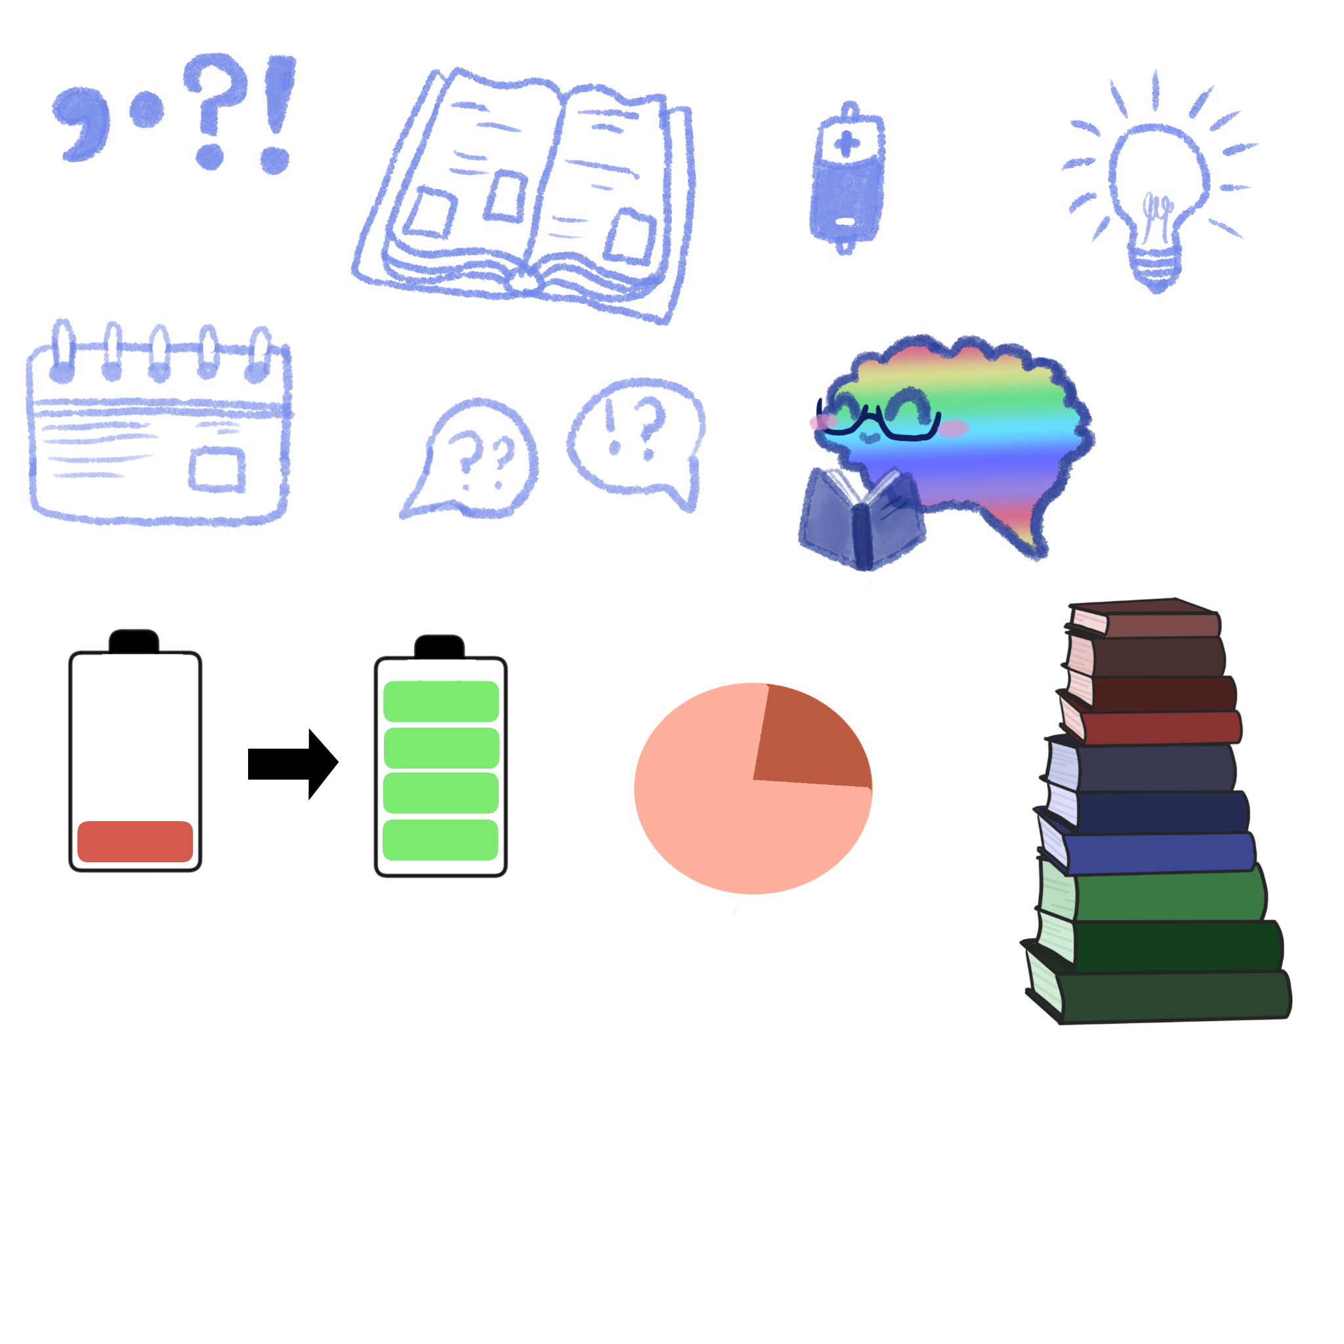
Neurotypical Perception and How to make the application process more accessible
CJ Harris
Notes:
Hello my name is cj harris, and this is my presentation on neurotypical perception and how to make the application process more accessible.
Going to be focusing on how to make it more accessible for autistic people specifically but their is a bit of cross over.

Slide 2

Presentation Layout
My experiences of the application process and interviews
Neurotypical perception
Universal Design and other resources
Notes:
And this is the layout, first my experiences, then neurotypical perception, and then universal design and other resources, those last two sections are based on my dissertation,
Which uses the social model of disability and I used the voices of autistic library professionals to drive my research results

Slide 3
Application Process experiences
Job applications rarely stated they were looking for disabled candidates in their inclusion statement, none that welcomed neurodivergent candidates
When their were roles aimed at disabled candidates, they were usually limited hours or an unlivable wage
Long application process: 1000 word statements, 15 plus essential criteria, criteria within criteria,
Lots of documentation to hand in as well as answering questions on the website
Notes:
Okay first application process experiences, these are my experiences as a medium surport needs autistic who is low masking, the job application really stated they were looking for disabled candidates in their inclusion statement, and none welcome to narrative version candidates. and then when the weather rolls that I found that were aimed at disabled candidates they were usually limited hours or unlivable wage, sor1 that was four thousand pounds a year and that personally isn't what I'm looking for, it also assumes that disabled people can work limited hours and don't need a livable wage,
and then in terms of when it came to writing the application usually personal statements I found that it was a very long process one of them had 15 pieces of criteria and wanted you to write 300 words for each of them which came to about 3,500 words in total and then when there was a lot of criteria they also had criteria within that criteria usually they wanted at least a thousand words for the application, I also found that there was a lot of documentation that they were asking for as well such as a CV personal statement and I've also had to fill in a quality one two forms that were separate to the ones on the website and then they also had individual questions on the website in top of the person statement that I'd already handed in which also wanted like 300 to 500 words for those questions, mostly I've been applying for library system roles occasionally some entry level librarian positions that yeah I found it to be quite a lot of work,

Slide 4
Application process
Some roles had short application time frames of 1-2 week
Found it difficult to provide all the information they were looking for within the short time frame
Rarely get through to interview
One application when I selected I am disabled, told me to tick another box that stated I wasn’t lying about having a disability in order to get an interview
Notes:
And and then the time frame fulfilling in the application was was often times quite short that one to two weeks for one and I found it difficult considering a lot of the time of the volume of information that they wanted didn't particulalry contrast well with the short time frame, Especially because times when I find jobs a lot of the time there's none for few months and then a bunch all in like one month so I'm doing maybe three or four at the same time and those have like two weeks to apply just doesn't really work, Especially because of like executive function like it's very difficult to have the motivation to apply for jobs when they want like like quite a lot of content from you, and then after that I have really gotten fruit interviews like I've had two since I started applying Which is about a year or two, And then one application When I selected that I have a disability another box came up two tick to make sure that I wasn't lying about having a disability in order to get an interview, which really does just show attitude towards disabled people really,

Slide 5
Interview experience
Before interview:
Asked for access requirements they were all denied, which put me at a disadvantage
Gave me very little information and had to ask where the interview would take place,
It also stated on the page for the interview that all the information I would need would be on that page,
I also asked what task I would be completing and they simply just rephrased what they had already said about it
Notes:
And then my interview experience, I primarily found the the two that I've had not good, I asked for access requirements like questions beforehand and also for them to take place in the quiet environment and they were denied which did put me a disadvantage, and they also gave me very little information about where the interview was and I had to ask where the interview would take place and the web page told me that all the information that I needed would be there and there was like basically just the interviewer's names and that was it, I also asked what task I would be completing and they simply just rephrase what they had already said that it would in fact be a work-based task which they already said that it would be a work-based task, which again not particularly good communication skills,

Slide 6
Interview experience
Before Interview
Was given 20 minutes to write notes to the interview questions,
The questions were long, vague and contained multiple questions in one
I was put in a loud part of the library to write notes, next to the door to the main stairs where I got overstimulated
Was Visible stimming and wore sensory aids and got dirty looks
Was told I looked nervous when I wasn’t masking
Notes:
And then And then before the interview I was given 20 minutes to write notes to the interview questions and the questions were very long and vague and contained multiple questions in one like I think at one point that was maybe three questions within one and they were maybe like maybe four lines long, and then to write the notes so is put in quite a loud part of the library and next to like the main door to the stairs well I got quite over stimulated, and in order to combat that I was feasibly stimming and I put on my sensory and I got dirty looks, and then when I stepped into the into a few room they told me that I looked nervous like that was the first thing that they said to me like not hello how are you it was immediately oh god you look nervous,

Slide 7
Interview experience
Spoke about a project that was unavoidable to not discuss disability, which got sighs, coughs and dirty looks,
When I mentioned I cared about access they huffed and rolled their eyes
When I turned to look at her doing this she gave me a condescending smile
Was rushed out the door when I finished asking questions,
Felt unsafe, judged and wanted to end the interview early
In another interview a interviewer asked if I had lost my voice or if I was just ‘like this’ and how would I be able to do presentations to another interviewer during the interview
When I lost my voice due to illness, I had told another interviewer before hand
Notes:
And then for actual interview experiences, so I spoke about a project that I've been a part of which just so happened to also involve discussing disability because it focused heavily on removing barriers for young people in the school context and this resulted in into one of the interviewers saying coughing and giving me dirty looks, Separately I also mentioned that I care about access and they also have to roll their eyes, and then because I wasn't making eye contact with them because it helps me to not look at people when I'm talking and I turned to them and she gave me a condescending smile and then afterwards I was rushed out the door when I finished asking questions super much said you know where the door is, yeah and during the whole process of felt and safe judged and I I wanted to end the interview early, and I also had another interview asked if I have lost my voice or if I was just like this and how would I be able to do presentations to another interviewer during the interview this was an online interview so I don't know if they were they thought they were muted, not really in that excuse for that anyway, but yeah I just lost my voice due to illness and I told another interviewer that beforehand and they let me do it online so at least one of the interviewers in that context tried to be accommodating but of course that was that down by them saying that,

Slide 8

Neurotypical perception
Neurotypicals are more likely to choose another neurotypical during the application process and vote autistics less favourably, less likable, untrustworthy and too honest
Autistic employees are often harassed by co-workers and feel unsafe around leadership and admin (Giles-smith and Popwich, 2023)
They struggle to read autistic emotions, form negative first impressions of us, based on their own social culture and experience
Misinformation also affects likelihood to emphasize with autistic people (Flower et al., 2021)
Notes:
okay so this section is on there to go for section as well as training and consequences which both next sections are based on my dissertation, which uses the social model of disability and encoprates the views off autistic library professionals. And I found the biggest barrier to access was neurotypical perception,
So typicals are more like these during that application process and autistics probably such as less like ball and trustworthy and to honest which is a little bit of a double negative there,
And because of this, Autistic people both miss out on employment opportunities but also drawing employment are often harassed by co-workers and fill and safer around library the leadership and admin,
Because they struggle to read autistic emotions they form negative first impressions this based on their own individual social culture and personal experience and also measure desirable narrative call personality traits instead of skills,
And then misinformation and stereotype around the autistic experience also affects likelihood to emphasize with autistic people, which I believe common stereotypes of autism in this context would be not being able to do teamwork, or form relationships with colleagues or stakeholders or be able to emphasize with users of the library,

Slide 9
Neurotypical perception
Neurotypicals still believe stereotypes about the autistic experience and make assumptions about autistic capabilities (Anderson, 2021)
They often measure body language, tone of voice and low social anxiety, and make first impression within first few moments of meeting, judging ‘verbal skill’ tone of voice, (Barrick et al., 2021)
Participant of my study also had their autistic traits brought up as negative in their feedback
Notion of ‘verbal skill’ is inherently ableist and it cancels out many disabled communities, including low speaking or non-speaking as well as different disability cultures
Casual ableism within neurotypical social culture, assumptions of laziness or faking
Library management label autistic as difficult (Maddock, 2022)
Notes:
And so going a little bit deeper into what I said on the previous slide, narratypicals still believe stereotypes about the autistic experience despite their being some emerging positive representations in the media. and also make assumptions about autistic capabilities, such as assuming that autistic person wouldn't be able to do a role that's heavy on teamwork or have a heavily like customer service based all like able to multitask the tasks, and they often measure body language social anxiety and make first impressions within first few moments of meeting.
And also looking for verbal skill which is turnable voice pitch as well as basically narutable traits really and then comparing that results of my distinction participants also found that when the feedback for the interviews was brought back they referenced autistic traits such as stimming being seen as nervous lack of I contactors lack of interest so there's a click connection with autistic traits being negative, and I would also like to point out that the notion of verbal skill is inherently exist and it cancels out many disabled Communities including low speaking to sticks as well as this dirty cultures that making UK in different ways such as the deaf community, also casual ableism within within narrative call culture such as assumptions of lazyness or faking when disabled people don't match their ideas of disability should look like, and then library management also label autistic people as difficult to manage and also have shown to hold bias about the disabled community and because of this many disabled people feel and safe around library leadership and admin staff.

Slide 10
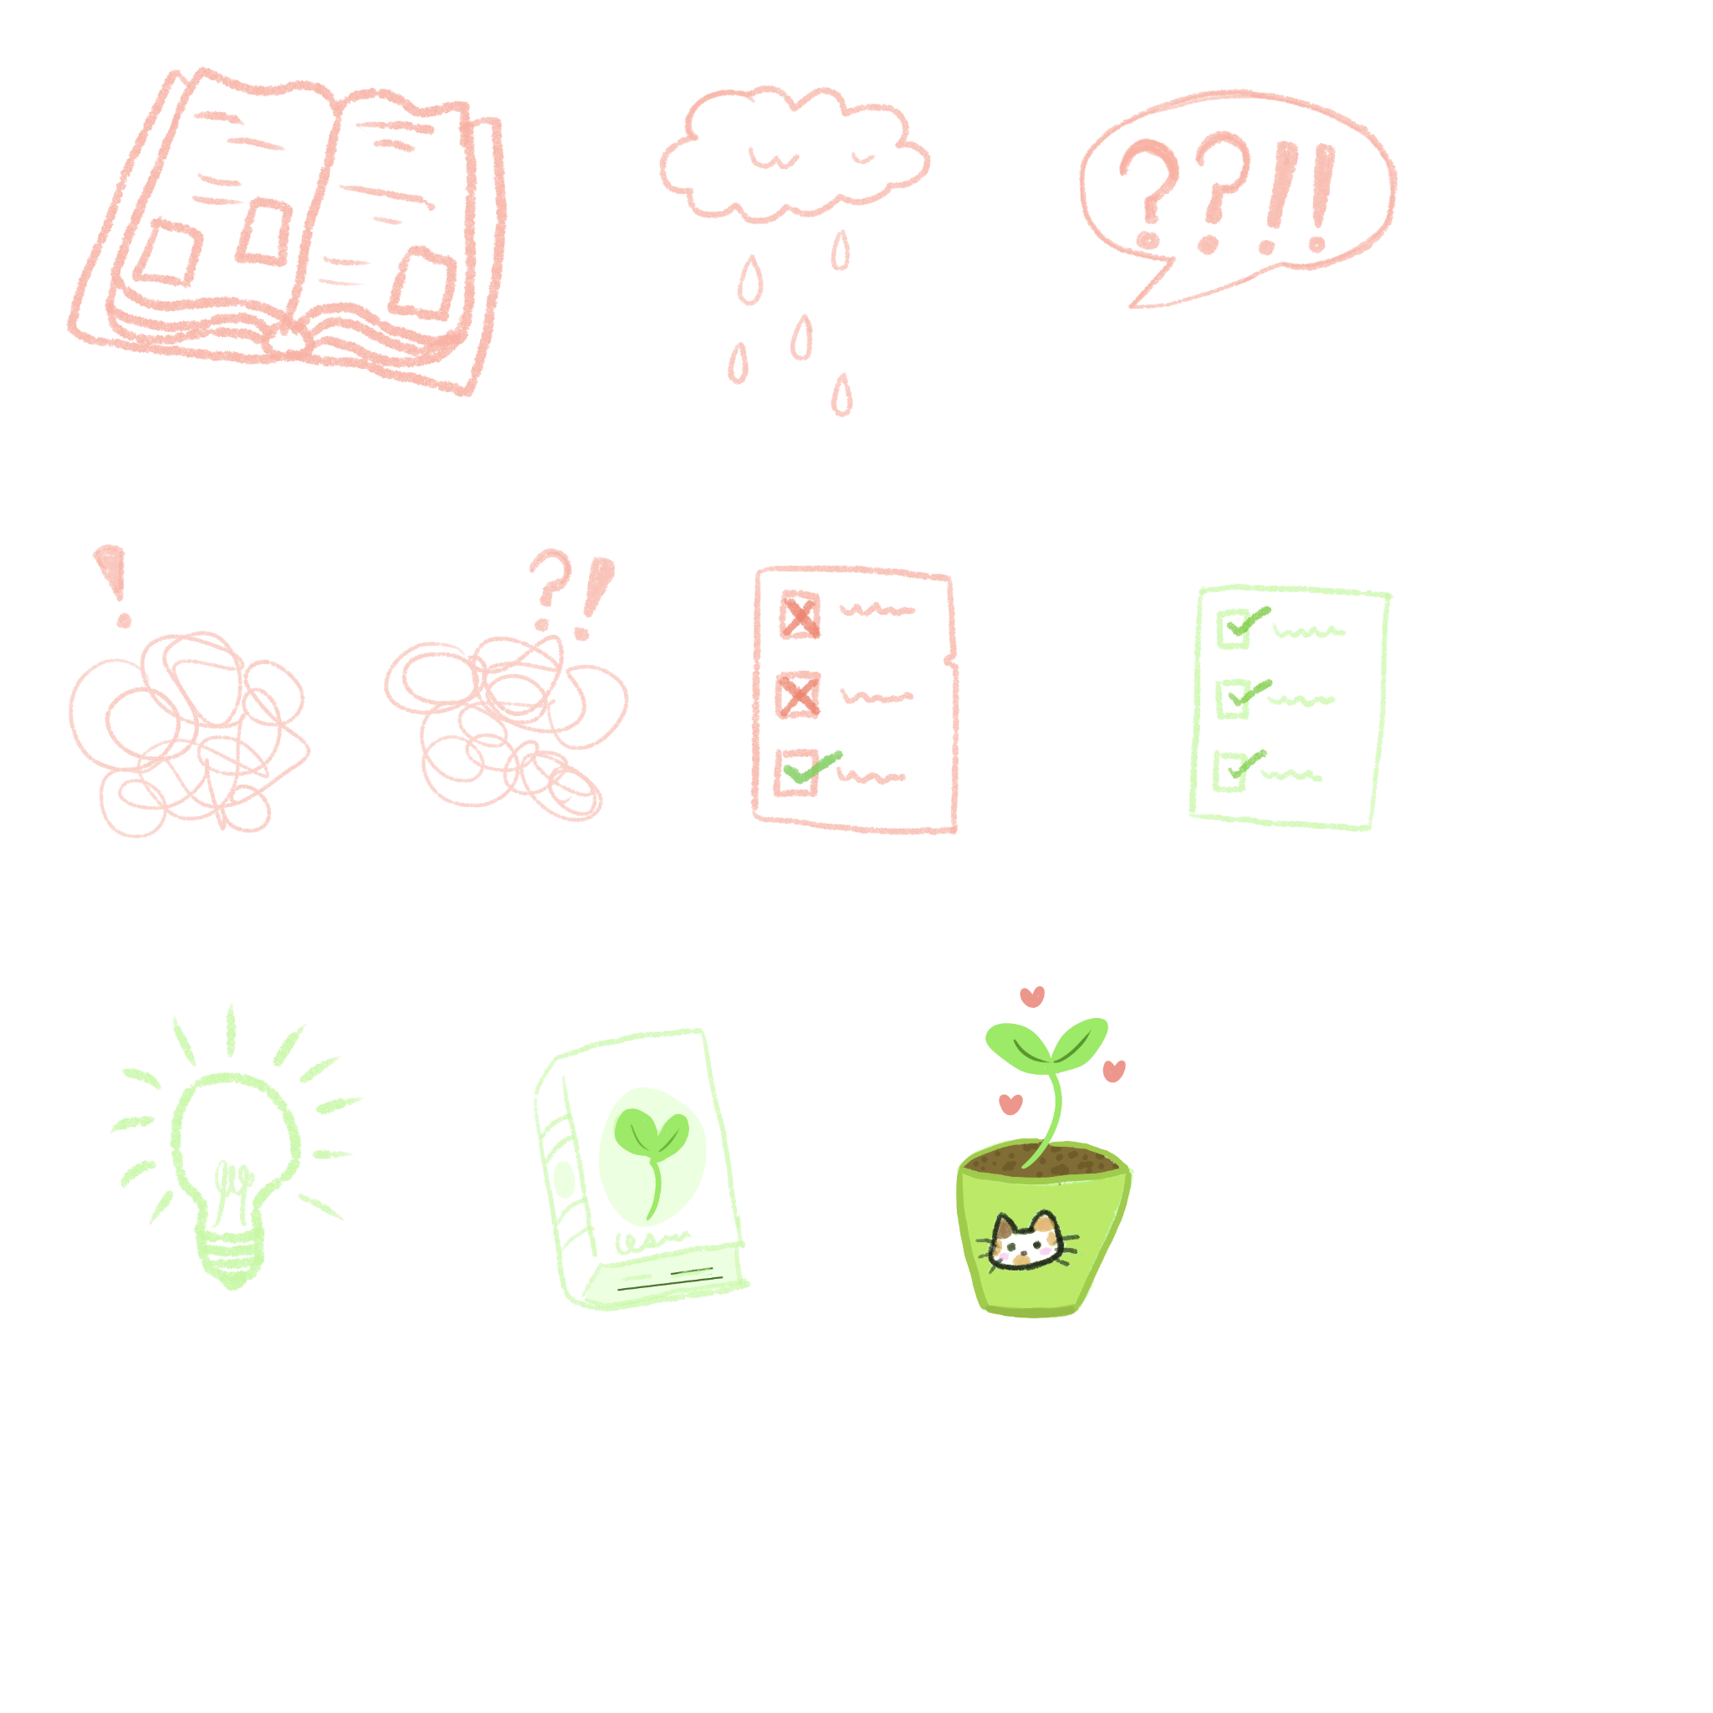
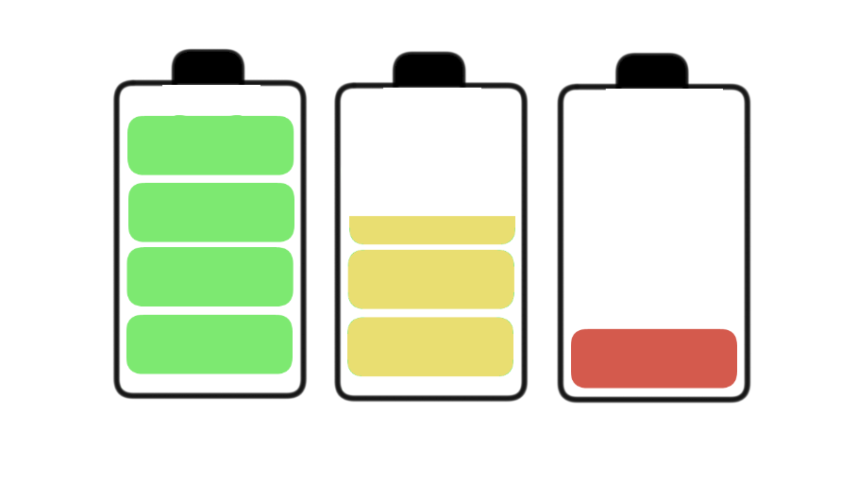
Neurotypical perception
These things all create an unfair disadvantage during the application process, as neurotypicals are measuring how well you can conform or mask rather then how well you can do the job
It’s also active discrimination
This negative perception often leads to denying access needs, and promotion, (participant of my dissertation)
Or not asking for access needs in fear of application being redrawn
Misconceptions about accommodation cost, less likely to take disabled person with invisible disability seriously
The application process is also not tailored for autistic people in mind
Notes:
And then these things all create an unfair disadvantage during the application process as no typical some measuring how well you can conform or mask rather than how well you can do the job as it is also active discrimination, but should do bring that up because I don't really see that mentioned very much in the literature like is very much saying narratypicals don't like this entire group of people instinctivel for meeting them but doesn't really say that this is wrong so I wanted to highlight that, and then this negative perception often leads to denying access needs and also promotion which was from a participant in my dissertation he was denied for promotion because they autistic, And also often leads to autistic people and disabled people in general not asking for their access needs infer the application being redrawn or like discriminated against, and narrative are called often experience misconceptions about accommodations costing money and they're less likely to take disabled person within invisible disperty seriously and the more likely to give I disabled person accommodation and they can see the disability And the application process is not tailored for autistic people in mind,

Slide 11
The double empathy problem
Neurotypicals and autistic people, have different communication styles
Both more likely to have ‘successful’ interactions with their own neurotype
Theirs mutual misunderstanding between both groups
Because neurotypicals have privilege they label autistics as at fault
They also experience anger from this misunderstanding as their not used to it,
Autistics mask their true selves to avoid discrimination and at a consequence to their mental health (Milton, Gurvuz & Lopez, 2022)
Too add: empathy imbalance, whilst autistics learn to understand neurotypicals, neurotypicals do not learn to understand autistics
Neurotypicals are also less likely to try to understanding other neurotypes or those outside their own individual experience
Notes:
Which brings me to why and this is one theory about that so the double empathy problem, which is narrative or cools and autistic people have different communication Styles and both are more likely to have successful interactions with their own neurotype and there is often mutual misunderstanding between both groups but oftentimes because no typicals have like the the social privilege enable autistic as it fault for this misunderstanding and label us as having a social communication deficit rather than a difference in communication, I often times when neurotypicals experience this misunderstanding they can often experience anger towards the autistic person because they're not used to it, which I guess also could look like Frustration and I've definitely experienced that as a non-masking autistic, and then as a consequence of this autistics master true cells to avoid discrimination at a consequence to their mental health often times these leading to burn out skill regression as well as anxiety and depression,
I would also like to add that that whilst there is a mutual misunderstanding between both groups I would also say that it is more of an empathy imbalance, because often times autistic people are a lot more likely to learn to understand narratypicals but autistics do not learn to understand autistic people because they do not have to and so don't often, Because they are the majority, And as well as that narrativicals are also less likely to try to understand other neurotypes all those outside their own individual experiences, I'd also seen that neurotypicals are oftentimes less likely to experience Emotional empathy because of this or at least like the same levels as of a neurotypes so the less likely to try and feel for people when they do experience hardship, which because of that it can be difficult to teach them about the autistic experience because education often times doesn't equal compassion, And empathy is definitely like an interesting subject and their are other neurotypes that have less empathy and doesn’t necessary mean it’s negative just need to find a different way to navigate that,

Slide 12
Consequences and training
Their currently is very limited repercussions for discrimination against autistic people and other neurotypes and training alone isn’t enough
Individuals who have no experience of disability and who hold bias against individuals from that community should not be allowed to determine whether our access needs are ‘reasonable’
Make the fair library jobs manifesto mandatory, to give accountability
Stronger legislation that makes it harder to freely discriminate against the disabled community, for example
‘ reasonable adjustments’ is quite ambiguous. So strengthening that to leave no room for error could be a starting point
Notes:
consequences and training they're currently is very limited repercussions for discrimination against autistic people and over neurotypes and training alone isn't enough, generally speaking individuals who have no experience of disability and who holds by us Against individuals from that community should not be allowed to determine whether our access needs are considered reasonable, That perhaps could be changed so instead of considered reasonable they perhaps could either only deny and accommodation if it equates to a certain cost which many times accommodations are free to enact or they could instead higher someone separately who enacts access requirements a nerve seen a few more of those kinds of jobs pop up lately, and then from a suggestion from a participant of my dissertation make the fair library jobs manifesto mandatory to help give accountability, and it also a place to report people for going against their manifesto as well,
and then as well as that the current legislation on their quality act currently isn't strong enough to stop discrimination against a disabled community because of terms like reasonable adjustments being ambiguous

Slide 13
Training
More in depth training, that portrays a wide range of the autistic experience outside of stereotype
Done by and with the influence of autistic people
Including non masking and autistics with more support needs
As well as how the autistic experience can appear different to their perception ie from masking, burnout or stress levels
Use of language preferred by the community, not deficit based and person first
Use the social model of disability instead of the medical model

Slide 14
Training that takes into account implicit bias
Training that focuses on explicit bias isn’t enough and neurotypicals can still experience implicit bias (Finn et al, 2023)
Autism acceptance training, creates less believe of stereotype, and more accurate understanding but, the autistic experience was still associated with negative personality traits (Jones et al., 2021)
Suggestions for improving implicit bias: embrace neurodiversity, create acceptance of neurodivergence and disability as a natural part of existence and not a personal failure
2nd: eliminate the assumption of neurotypicals ‘knowing best’ as prevents from acknowledging wrongdoing.
By using autistic voices, it lets us talk about our own experiences without being spoken over, expert off own experience (Legault et al., 2024)

Slide 15

Universal Design
Current application process puts autistic candidates at a disadvantage,
With vague questions, unclear processes, last minute changes
Universal design helps prevents access from being denied as access is already In place
Prevents disclosing from being necessary to get what you need
Including changes to the physical environment, having an interpreter or changing the process
Updates to process when notice it's inaccessible with user feedback
Benefits all candidates, as everyone's needs are met
Use disabled people too help mould the new process (Guder, 2014)
Notes:
So the current job application process put autistic candidates at a disadvantage if they questions unclear processes and last minute changes, for example one of the participants of my study was told that they would be doing a presentation and last minute they said that there would be no presentation and they went straight to interview, and a large part of why the current application is an accessible is because of negative perception towards autistic people, which was the biggest barrier I found, but also many other aspects of the application process is inaccessible, so here are some ways that that can start to be fixed, using the concept of universal design, universal design helped prevent access from being denied as access is already in place, which prevents disclosing from being necessary to get what you need, Some examples of this could be changes to physical environment, This could be changing locations to your room that's more quiet or switching the lights off and only having like a singular light their, And then making sure that that process is adaptable to new user feedback when they experience in access in that environment, so it's a living process that's constantly updating, and having at Universal the accessible benefits all candidates as everyone's needs in there not just disabled people, And then using lived experience of disabled people to help Mold a new process.

Slide 16
Universal Design- what to add
Clearer communication- interview questions in advance that are clear and single questions, where the interview will be held and what the process will entail for example, presentation on access
Adaptations to physical environment such as: held in a quiet environment with non harsh lighting, not too cold or warm
Positive social environment: treat the candidate fairly and not too formally
Informal chat instead of traditional interview, go into more detail about achievements, less pressured environment
Work based assessment to show skill instead of personality (Anderson, 2021)
Mention in job description value neurodivergent staff
Notes:
Next here are some there are some things that could be added to the current application and interview process in order to to make it more accessible for specifically autistic candidates but could also apply to other neurotypes potentially, such as clearer communication and this would include interview questions in advance that I clear and singular questions with and where the interview will be held and what the process will entail and different elements of the process such as an presentation or work trial and what the presentation would need to be on what the work trial would specifically be, and then add adaptations to the physical environment such as being held in the quiet environment with non harsh lighting as well as making sure the temperatures regulated, which can be an issue for chronic conditions which are co-morbities, and then making sure that there is a positive social environment so trees in the Canon to the fairly and unformally, and so they can go into more detail about achievements and it's the less pressure environment, and also prioritizing skills over personality, so an example of this could be a work based assessment to show skills, and also to mention in the job description that they value neurodivergent staff,

Slide 17
Universal Design- criteria changes and guidelines
Improved criteria to be more skill based instead of using personality traits like ‘friendly’ or ‘confident’
Less criteria as well as keeping criteria separate, no criteria within criteria
Clear criteria
Guidelines of access requirements for recruiters and how to implement them, and so autistic candidates are aware what is currently offered
Guidelines also include differences in social communication styles
Not mark down for exhibiting autistic traits, social component not measured
Seek to welcome neurodivergent staff and not treat them less than
Notes:
And then to change how the current criteria for jobs is administered so changing to be more skill-based over personality traits like friendly or confident, and then less criteria as well as keeping criteria separate and know criteria within a criteria such as such as having good iced good it skills and able to learn things quickly, I also making sure that their criteria is an ambiguous as well
And then having clear guidelines of access requirements for recruiters and how to implement them and so autistic candidates are aware what is currently offered, Much of the literature talks about they're not being guidelines for implementing adjustments for invisible disabilities so having that standard in place could also prevent access requirements from being denied if the current job application process at by institution doesn't have that specific requirement in place, and the guidelines could also include different in social communication Styles and not Mark social skills hallmark candidates down for exhibiting autistic traits, or any other social differences that they deem as negative, and also seek to welcome narrative versions staff and not treat them less than and embrace differences and strengths.

Slide 18
Universal Design- fair library job manifesto
Another suggestion by a participant in my dissertation was to make the fair library jobs manifesto mandatory to hold recruiters accountable
Stands for transparency: clear processes and requirements
Equity: remove processes that are inaccessible and result in underrepresentation
And respect for applicants time and well being
Some standards including:
No duplicated criteria, transparent
Clearly stated closing date and time
Necessary information asked for only, not have to fill in information multiple times
Reasonable adjustments should be actioned quickly
Direct questions and short
Share interview questions in advance
Follow up interviews only when necessary and let know in advance
Provided with meaningful feedback about their performance if unsuccessful;
Allow feedback from candidates (Fair Library Jobs, 2024)
Notes:
an example of existing guidelines in the library and information sector is a fair library job's manifesto, which was enough suggestion by our participant in my distinction, and to make this standard mandatory for recruiters to hold them accountable, and they stand for transparency so making the processes clear and the requirements clear as well, as well as equity by removing processes that are inaccessible and result in underrepresentation and make sure to give kind of disrespect for their time and their well-being, some standard The align with neurodivergent access requirements include, making sure there's no duplicated criteria and making sure the criteria is transparent and not vague, and clearly stating the closing day and time, and then only asking for necessary information and not having to fill in the same information multiple times, and then making sure reasonable just months are actioned quickly, And then making sure interview questions are direct and short as well as to share the interview questions in advance and then to follow up interviews only when necessary and that candidates know in advance and then afterwards providing meaningful feedback about their performance if unsuccessful, and also to that candidates provide feedback to the employer as well.

Slide 19
Universal Design- initiatives
Because of high unemployment rates for autistic people, initiatives could be a way to bypass inaccess of the application process and increase representation
Limited initiatives within libraries but within other fields their is ambitious about autism, internship programs to help autistic people gain access to work and gain experience,
Application process more accessible, less criteria that is clear, tick box skill selection and low word counts
SAP’s ‘Autism at work’ program to hire more autistics within technology, skill demonstration and portfolio says it embraces autistic strengths (Anderson, 2021)
Networks such as NLISN also important create networking opportunities as well as solidarity
Notes:
So because there is a high rate of unemployment within the autistic community away to buypass the inaccessibility of the current hiring process could be too facilitate initiatives in order to hire more autistic and neurodivergent people.
one that I have encountered recently was with ambitious about autism and for that one and the job description had very small amounts of criteria that were very clear and then for the application I had like box selection of skills and then to summarize how I met a selection of those skills in 100 to 200 words but I found to be accessible because it took less time and had more of an idea for what they're looking for.
And then we have because there are limited initiatives specific to library and information sector the is an initiative hiring autistic people within technology called autism at work, seeking to hire autistic people of in technology
and then finally we have organizations like endless because it brings narrative version people together for both networking and solidarity I feel like safety in numbers as very much an important component because if there's a lot of us they can't really ignore but like if it's just like one of us supply for job than there a bit like so yeah

Slide 20
References
Guder, C. (2014). Universal Design and the library website. Public & Access Services Quarterly, 10(3), 229–237. https://doi.org/10.1080/15228959.2014.931784
Milton, D., Gurbuz, E., & López, B. (2022). The ‘double empathy problem’: Ten years on. Autism, 26(8), 1901–1903. https://doi.org/10.1177/13623613221129123
Giles-Smith, L. & Popowich, E. (2023). Autistic Employees in Canadian Academic Libraries: Barriers, Opportunities, and Ways Forward. Canadian Journal of Academic Librarianship / Revue canadienne de bibliothéconomie universitaire, 9, 1–22. https://doi.org/10.33137/cjal-rcbu.v9.39994
Flower, R. L., Dickens, L. M., & Hedley, D. (2021). Barriers to employment: Raters’ perceptions of male Autistic and Non-Autistic candidates during a simulated job interview and the impact of diagnostic disclosure. Autism in Adulthood, 3(4), 300–309. https://doi.org/10.1089/aut.2020.0075
Anderson, A. M. (2021). Exploring the workforce experiences of autistic librarians through accessible and participatory approaches. Library & Information Science Research, 43(2), 101088. https://doi.org/10.1016/j.lisr.2021.101088
Barrick, M. R., Dustin, S. L., Giluk, T. L., Stewart, G. L., Shaffer, J. A., & Swider, B. W. (2011). Candidate characteristics driving initial impressions during rapport building: Implications for employment interview validity. Journal of Occupational and Organizational Psychology, 85(2), 330-352. https://doi.org/10.1111/j.2044-8325.2011.02036.x
Maddock, K. (2022). To what extent are autistic library staff in the UK supported in their workplace? [Masters Dissertation]. University College London. https://open-education-repository.ucl.ac.uk//902/1/Maddock%2C%20Katherine%2021-22.pdf
Finn, M., Flower, R. L., Leong, H. M., & Hedley, D. (2023). ‘If I’m just me, I doubt I’d get the job’: A qualitative exploration of autistic people’s experiences in job interviews. Autism, 27(7), 2086–2097. https://doi.org/10.1177/13623613231153480
Jones, D. R., DeBrabander, K. M., & Sasson, N. J. (2021). Effects of autism acceptance training on explicit and implicit biases toward autism. Autism, 25(5), 1246-1261. https://doi.org/10.1177/1362361320984896
Legault, M., Catala, A., & Poirier, P. (2024). Breaking the stigma around autism: moving away from neuronormativity using epistemic justice and 4E cognition. Synthese, 204(3). https://doi.org/10.1007/s11229-024-04730-9
Fair Library Jobs. (2014). Manifesto. https://sites.google.com/view/fairlibraryjobs/manifesto

Slide 21
Thank You for listening!

