Slide 1

What does it mean to be information literate for an autistic person working in the academic library workplace?
Amelia Haire

Slide 2
Contents
1.The Why
2.What does it mean to be information literate, and how does that apply for an autistic person in the workplace?
3.The How (Methods)
4.Findings
Epistemic
Social
Physical
5. Implications/Further Research
6. Questions

Slide 3
Why?

Slide 4
What does it mean to be information literate?
“Information literate people will demonstrate an
awareness of how they gather, use, manage, synthesise and create information and data in an ethical manner and will have the information skills to do so respectively.”
-The Society of College, National and University Libraries (SCONUL)

Slide 5
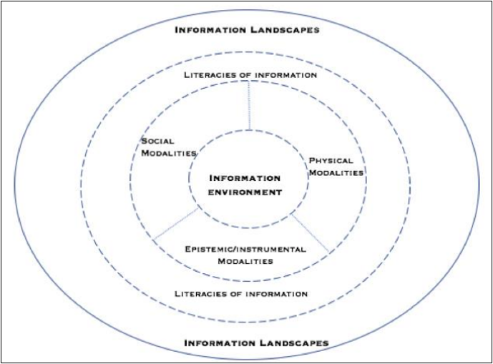
What about being information literate in the workplace?
SOCIAL
PHYSICAL
EPISTEMIC
(Lloyd, 2017, p. 98)

Slide 6
[The] [p]rimary sources of information, which are required for effective practice and professional development […]
-textual sources
-social sources
-physical and sensory sources (Lloyd, 2005, p.85)

Slide 7
How would this be different for an autistic person?
Key challenges for an autistic person:
-Communication (literal, facial expressions, small talk)
-Hypo- or Hyper-sensitive to physical surroundings
-Processing

Slide 8
“Why do you think there is so little literature about the neurodiversity of
librarians?” (Eng, 2017).

Slide 9
Traditional resource practices that do little to encourage meaningful participation from autistic adults" (Anderson, 2021, p.1)
"[There is a] continual societal focus on children with autism, although that is slowly changing" (Eng, 2017)
"[T]he reported desires and wants of Autistics are rarely, if ever, considered, because it is misguidedly believed that everything one needs to know about Autistics can be inferred from their medical classification" (Lawrence, 2013, p.104)
Resources on supporting patrons in the library, but not the workers.

Slide 10
Methods
Survey
Sent out to the NLISN network.
43 responses.
Questions format ranged from drop-down (Completely agree- Completely Disagree) to free text.
Different Sections for each modality, and another for the onboarding process.
Interviews
2 participants
"Guided Interview" approach
30-90minutes.

Slide 11
Findings
Epistemic
Preference for the written record
Social
Translation of Information
Physical
Sensory Challenges

Slide 12
Epistemic
The ways information is socially transmitted in her new workplace. If those ways are unnecessarily complicated […] it becomes more difficult for the new person to do their job (Galoozis, 2014)

Slide 13
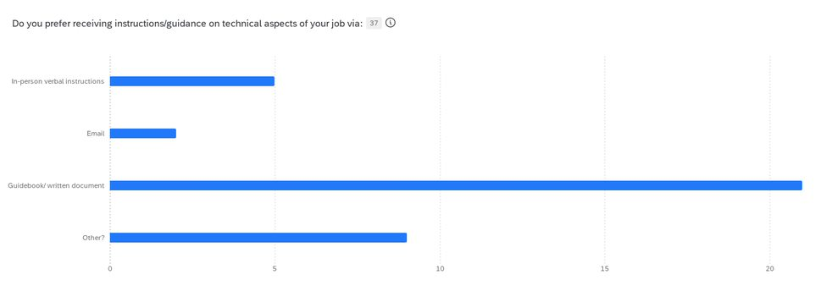
Epistemic
Notes:
Explicit vs tacit knowledge

Slide 14
Social- Active translation
The main social difficulty is "not understanding what's behind the words" (Participant B)
"they'll tell me a load of irrelevant stuff and I've got to take that and translate it into a process"(Participant A)
"When I present it tends to be much shorter, much more concise. […] Just tell me what you want and we'll do it" (Participant B)

Slide 15
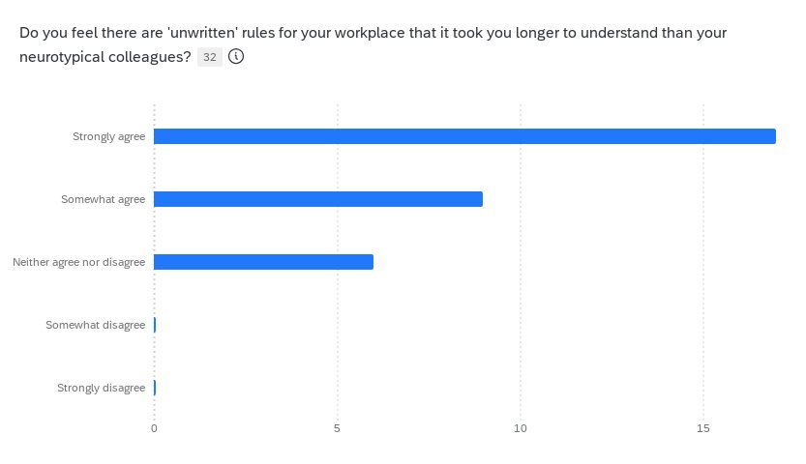
Active Translation

Slide 16
"There are workplace dynamics/expectations which people can't really explain or define clearly- there's an expectation that I will just know things or "get a vibe""- Survey Participant

Slide 17
Physical
"It's like if you were pouring water over a neurotypical person's head while explaining something and they have to pay attention and also they have to pretend not to notice the water"- Survey Participant

Slide 18
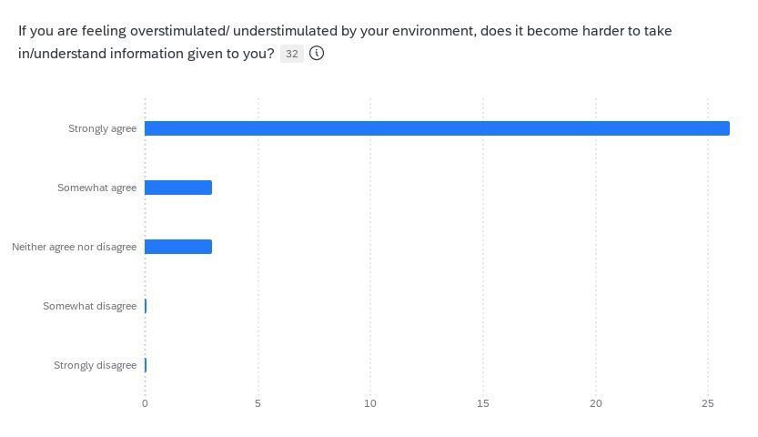

Slide 19
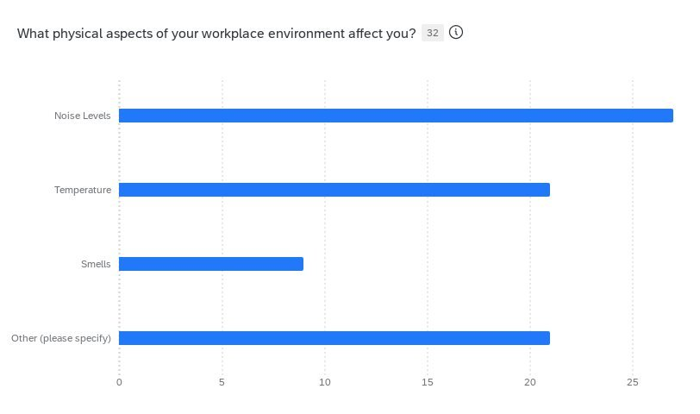

Slide 20
"I'm like a little swan paddling below. There's the water line and I look very serene above it. And below I'm just going like this [makes frantic paddling motions]"- Participant A

Slide 21
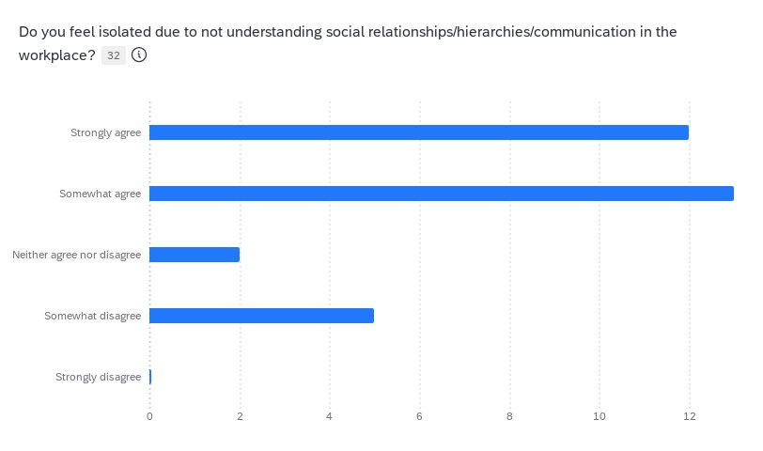
Implications/Further Research

Slide 22
Implications/Further Research
Ways in which autistic librarians should be celebrated:
-Pattern Recognition
-Methodical/Logical Approach (Data-oriented)
-We are ALWAYS translating information
Ways in which you can help your autistic colleagues:
-Consider having written guides for what you expect of them, and what they should expect of you.
-Ask them what their sensory needs are (if they need a quieter area sometimes, let them stim, whether you could change from fluorescent lights...)

Slide 23
Questions?

Slide 24
NLISN
Buddying Scheme
    Connects neurodivergent librarians.
Resources
    Events, journals, articles, reports.
Newsletter
    Up-to-date with NLISN outputs

Slide 25
References
Anderson, A. (2021). Job Seeking and Daily Workforce Experiences of Autistic Librarians. The International Journal of Information, Diversity, & Inclusion, 5(3). Available at: https://jps.library.utoronto.ca/index.php/ijidi
Eng, A. (2017). “Neurodiversity in the Library: One Librarian’s Experience”. In In the Library with the Lead Pipe. Available at: https://www.inthelibrarywiththeleadpipe.org/2017/neurodiversity-in-the-library/
Galoozis, E. (2014). “Me and you and everything we know: information behaviour in library workplaces”. In In the Library with the Lead Pipe. Available at: https://www.inthelibrarywiththeleadpipe.org/2014/me-and-you-and-everything-weknow-information-behavior-in-library-workplaces/
Lawrence, E. (2013). Loud hands in the library: Neurodiversity in LIS Theory & Practice. Progressive Librarian, 41, pp. 98–109
Lloyd, A. (2005). Information literacy: Different contexts, different concepts, different truths? Journal of Librarianship and Information Science, 37(2), 82–88.
Lloyd, A. 2017. Information literacy and literacies of information: a mid-range theory and model. Journal of Information Literacy 11(1), pp.91-105.

